Slide 1


2026 Open Enrollment

Slide 2
BlueCard Program
National access to
Take your healthcare benefits with you when you travel.
With the BlueCard program, you have access to doctors
and hospitals around the country.
Advantages
In-network benefits coast to coast through BlueCard PPO providers
Reduced out-of-pocket costs
No claim forms
No billing hassles
Access to Services
Providers in the BCBS Plan area where you receive services
Provider identifies BlueCard PPO
Providers file claims directly for you when you access a BlueCard PPO Provider
95%
of all doctors
96%
of all hospitals

Slide 3

PPO Plan
In-Network benefits
Deductible: $500 individual/$1,000 family
Out of Pocket Max: $6,600 individual/$13,200 family
PCP/Specialist copayment: $20 / $40 no deductible
Inpatient Hospitalization: $250 copay after deductible
Outpatient Surgery $75 copay after deductible
Generic formulary $10 copay
Brand formulary: $20 copay
Non-formulary: $35 copay
Preventive care covered at 100% no deductible

Slide 4

HSA High Deductible PPO
In-Network benefits
Deductible (Aggregate): $2,000 individual/$4,000 family
Out of Pocket Max: $4,000 individual/$8,000 family
All Services: 90% after deductible
Generic formulary: $10 copay after deductible
Brand formulary: $20 copay after deductible
Non-formulary: $30 copay after deductible
Preventive care covered at 100% no deductible

Slide 5
Plan Comparison Chart
Benefits | PPO $500 |  | HSA HDHP $2,000
 | In Network | Out of Network | In Network | Out of Network
Deductible (Single/Family) | $500/$1,000 (Embedded) | $5,000/$10,000 | $2,000/$4,000 (Aggregate) | $5,000/$10,000
Coinsurance | 0% | 50% | 10% | 50%
Annual Out-of-Pocket Limit (Individual/Family) | $6,600/$13,200 | $15,000/$30,000 | $4,000/$8,000 | $10,000/$20,000
PCP Visit | $20 Copay | 50% after deductible | 10% after deductible | 50% after deductible
Specialist Visit | $40 Copay | 50% after deductible | 10% after deductible | 50% after deductible
Routine GYN | $20 Copay | 50% after deductible | 10% after deductible | 50% after deductible
Inpatient Hospital | $250 Copay after deductible | 50% after deductible | 10% after deductible | 50% after deductible
Outpatient Surgery | $75 Copay after deductible | 50% after deductible | 10% after deductible | 50% after deductible
X-ray/Radiology | $50 Copay after deductible | 50% after deductible | 10% after deductible | 50% after deductible
Laboratory | 100% after deductible | 50% after deductible | 10% after deductible | 50% after deductible
Emergency Room Copay | $150 Copay after deductible | 50% after deductible | 10% after deductible | 50% after deductible
Virtual Care (Telemedicine, Telebehavioral health and Teledermatology) | Telemed $20 copay Telederm $40 copay Telebehavioral $40 copay | Not Covered | 10% after deductible | Not Covered
Notes:
This grid is intentionally blank. Please fill in your group’s specific information.
LG/SG plans do not have a line for telemedicine anymore, it's renamed Virtual Care - then it usually mentions all the Teladoc products under this umbrella: Telemedicine, Telebehavioral health and Teledermatology - these are Teladoc products, a PCP may offer Telemedicine services but they follow the plans copay

Slide 6

Health and Well-being Programs

Slide 7




Preventive care guidelines
Annual preventive screening recommendations
Review the recommendations below, then make an appointment with your doctor today.
Preventive exam screenings
Comprehensive history and physical exam findings
Vital signs: Blood pressure, heart rate, respiration rate, temperature
Lab tests and counseling: Age- and gender-appropriate counseling and preventive screenings (your doctor will provide a prescription for any recommended lab tests)
Getting preventive care is an important part of staying healthy.
Talk to your doctor or contact a Registered Nurse Health Coach directly about preventive care and how it’s covered for you and your dependents.
Call 1-833-242-3030 (TTY: 711).
To view the full preventive schedule, visit ibx.com/preventive.
Preventive care is the routine care and counseling you receive to prevent health problems. It’s one of the best ways to prevent illness and detect diseases before they become serious medical conditions.
Preventive care can include:
Learn about your covered benefits
Log in at myibxtpabenefits.com to review your preventive care benefits.
If you have any questions, call the number on the back of your member ID card.
Preventive care for adults
Physical exams, age 18 and older
Blood pressure, all ages
Flu shot, all ages
Colorectal cancer screening, age 45 and older²
Preventive care for women
Pelvic and clinical breast exam
Pap test, beginning at age 21
Mammogram,age 40 and older
BRCA genetic testing²
The information in this document is an overview of preventive care guidelines for average risk and is not a complete list.
Preventive care coverage is subject to change based on updated recommendations.
How preventive care is covered
Under your health plan, you may be eligible to receive preventive care with little or no cost-sharing when using an in-network provider. Some services may require preapproval. If a service is not considered preventive (e.g., diagnostic procedures or ongoing treatment for an existing condition) or you don’t fall within the coverage guidelines, cost-sharing may apply.
Immunizations (e.g., pediatric vaccines, flu shot)
Checkups Cancer and other (annual physicals health screenings and well visits) (e.g., mammogram,
colonoscopy, heart health)
Preventive care recommendations are based on age, gender, family history, and health. Talk to your doctor about which preventive services are appropriate for you.
For the latest guidelines, visit medpolicy.ibx.com and type Preventive Care Services, Policy #00.06.02, in the search field.
24156 3962954 (11-25)

Slide 8


Virtual Care Solutions
Medical
Behavioral Health
Teladoc Health General Medical
PCP/Specialist who offer virtual care
Teladoc Mental Health Care
Provider network in all 50 states who offer virtual care, including Connect to Care network providers
Telenutrition
In-network nutritionists who offer virtual care
HUSK Nutrition via HUSK Marketplace
Dermatology
Teladoc Dermatology
Dermatology specialists who offer virtual care
Teladoc General Medical, Teladoc Mental Health Care, and Teladoc Dermatology are included in your health plan
Notes:
Confirm that all Teladoc products are included in their health plan as well as the other benefits listed on this slide.

Slide 9



Partner Point Solutions
Seamlessly integrated
Virtual physical care program to help prevent and treat acute, chronic, and post-surgical pain
Virtual Pelvic floor therapy program
An integrated, comprehensive fertility and family building benefit
Independent companies engaged under contract to provide services to customers.

Slide 10
Sword Health
A digital physical therapy program to prevent and treat pain
Pick your licensed physical therapist.
Get your Sword kit complete with motion trackers and a tablet.
Stay connected with your physical therapist anytime.
Complete your exercise sessions whenever is convenient and feel the relief.
Get started!
Download the Sword Health app from the App Store or Google Play
10

Slide 11


Slide 12
Progyny
Progyny provides an inclusive family building
benefit for every unique path to parenthood.
Comprehensive fertility treatment coverage leveraging the latest technologies and treatments
Access to the largest network of premier fertility specialists
Unlimited concierge support from a dedicated Progyny Patient Care Advocate (PCA) through each phase of your family building journey
Curated education across family building milestones and transitions, through articles, videos, podcasts and more
Learn how to enroll!
Ask your benefits team for more information
12

Slide 13
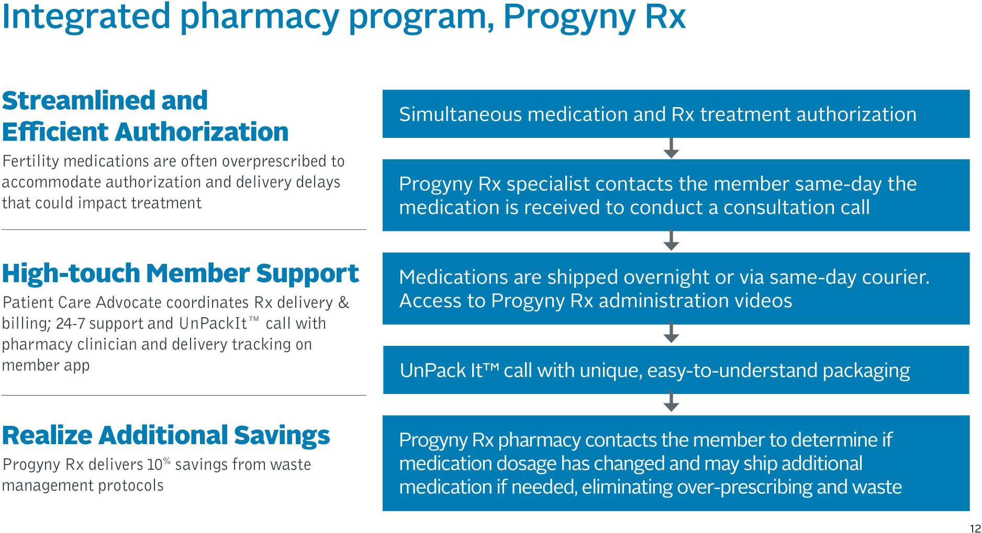

Slide 14

Member
Tools

Slide 15
AblePay (NEW )
Save up to 13% on out-of-pocket medical costs when you sign up for a
free AblePay membership and use an AblePay provider.
Enroll to get started
Enrolling in AblePay is simple, and there are no monthly or annual fees. Visit ablepayhealth.com/ibx to get started. Then, follow these steps:
Click on the Enroll Now! button
Enter the requested demographic information
Add family members whom you are responsible for (they can have a different insurance plan)
Enter your health insurance information
Add your default payment term and payment method(s)
Then you’ll have access to the AblePay member portal, and AblePay will mail your AblePay card(s).
AblePay is free and available to you through your employer, whether or not you are an IBX plan member. AblePay makes it easier to understand and pay for out-of-pocket medical expenses:
Save up to 13% on out-of-pocket medical costs, including copays, coinsurance, and deductibles
Conveniently pay your medical bills in one place using the secure AblePay member portal
Choose a flexible, interest-free payment plan option that fits your financial needs
Talk to a member advocate, who can answer questions about billing or payments (before or after you’ve received care) and who can contact the provider on your behalf, if needed
Notes:
Program benefits:
Savings
You can immediately save on out-of-pocket medical expenses. AblePay Members save up to 13% on medical expenses not covered by their health insurance plan.
Flexibility
Everyone has different ﬁnancial circumstances, so we provide payment options on every bill we process. We also make paying your bills easy by accepting ACH transactions (bank accounts), credit/debit cards, and health savings accounts (HSA)/ﬂexible spending accounts (FSA). You choose what works for you!
Convenience
All medical bills are stored in your Member Portal, eliminating stacks of paper and providing easy access. Bills are paid directly through your secure portal with a click of a button, eliminating the need to write multiple checks.
Advocacy
Our claims experts are available to help you with questions regarding billing issues or payments prior to or after seeking medical care. We contact the provider on your behalf. We work for our Members!

Slide 16
AblePay
Save up to 13% on out-of-pocket medical costs when you sign up for a
free AblePay membership and use an AblePay provider.
Enroll to get started
Enrolling in AblePay is simple, and there are no monthly or annual fees. Visit ablepayhealth.com/ibx to get started. Then, follow these steps:
Click on the Enroll Now! button
Enter the requested demographic information
Add family members whom you are responsible for (they can have a different insurance plan)
Enter your health insurance information
Add your default payment term and payment method(s)
Then you’ll have access to the AblePay member portal, and AblePay will mail your AblePay card(s).
AblePay is free and available to you through your employer, whether or not you are an IBX plan member. AblePay makes it easier to understand and pay for out-of-pocket medical expenses:
Save up to 13% on out-of-pocket medical costs, including copays, coinsurance, and deductibles
Conveniently pay your medical bills in one place using the secure AblePay member portal
Choose a flexible, interest-free payment plan option that fits your financial needs
Talk to a member advocate, who can answer questions about billing or payments (before or after you’ve received care) and who can contact the provider on your behalf, if needed
Notes:
Program benefits:
Savings
You can immediately save on out-of-pocket medical expenses. AblePay Members save up to 13% on medical expenses not covered by their health insurance plan.
Flexibility
Everyone has different ﬁnancial circumstances, so we provide payment options on every bill we process. We also make paying your bills easy by accepting ACH transactions (bank accounts), credit/debit cards, and health savings accounts (HSA)/ﬂexible spending accounts (FSA). You choose what works for you!
Convenience
All medical bills are stored in your Member Portal, eliminating stacks of paper and providing easy access. Bills are paid directly through your secure portal with a click of a button, eliminating the need to write multiple checks.
Advocacy
Our claims experts are available to help you with questions regarding billing issues or payments prior to or after seeking medical care. We contact the provider on your behalf. We work for our Members!

Slide 17






Personalized Support
Need a little help? We offer an added level of personalized support when you’re managing more complex health challenges to help you achieve better health.
Registered Nurse Health Coach
When you call our health information line, registered nurse Health Coaches are available 24/7 to answer questions about your health and treatment options.
Case Management
Our free, confidential case management program connects you with registered nurses and social workers who can help you navigate complex medical conditions.
Personal Health Record
Stay on top of your health with this digital health diary that automatically updates with your office visits, surgeries, and tests.
Baby Beginnings®
Our free, comprehensive maternity program supports members across the pregnancy spectrum from the first trimester through delivery to home and continues with the 24/7 availability and support of Registered Nurse Case Managers and digital communications.
Condition Management
Condition management is available at no cost to most members. Please refer to your member materials for the terms, limitations, and exclusions of your health care coverage, or call Customer Service at the number on the back of your medical ID card to find out if you are eligible.
Health Resources
You can read the latest articles on a variety of healthy lifestyle, fitness, and nutrition topics.

Slide 18


Discounts and Reimbursements
Discounts on entertainment and events
Blue InsiderSM offers great deals on family-themed activities like movie and theater tickets, sporting events, museums and zoos, and travel.
Exclusive deals
Save on health-related products and services with exclusive value-added discounts and offers from Fitbit®, KIND Snacks®, Garmin®, Nutrisystem®, and others with Blue365.

Slide 19
A Champion can help navigate every aspect of your care, so you can live your healthiest life.
Call when you need:
• Help understanding your benefits. A champion knows your benefits and can help you get the most from your health plan.
• Support from a Vistia Health Registered Nurse. Get one-on-one support for your physical, behavioral, and even financial well-being.
• Guidance from a care team. We can connect you to a multi-specialty care team if you have more complex health challenges.
Call your Champion Team: 1-833-382-3500
Notes:
Allows us to infuse our brands with vitality aligning objectives with the IBX mission
A critical tool helping the team evaluate design work
Provides a written agreement of what we hope to accomplish with each project
Brings to life the business objectives in a way that is member-driven, relevant and inspiring to the creative resources
Allows us to be faster to market by focusing our efforts in the right place
Ensures that we look before we leap, using time efficiently
Defines both areas of exploration and inflexible parameters
Provides a roadmap of how a project will be managed
Provides a succinct and uncluttered communication hiearchy

Slide 20
©2025 Independence Administrators
Independence Administrators is an independent licensee of the Blue Cross and Blue Shield Association.
All Rights Reserved. May not be copied or distributed without authorization

Slide 21


SlateRx Overview
21
CONFIDENTIAL ©2026 SlateRx

Slide 22
Get the medications you need—without the hassle
Who is SlateRx?
SlateRx partners with Optum Rx to administer the reviews for coverage of medications. For certain medications that need a clinical review (prior authorization or coverage determination) prior to being filled, you will contact SlateRx.
Who is Optum Rx?
Optum Rx supports your prescription benefits by:
Providing a retail pharmacy network
Confirming which medications are covered under your benefit
Answering questions about your cost share
Coordinating medication home delivery through Optum Mail and Optum Specialty pharmacies
Providing online member support tools at OptumRx.com or in the Optum Rx mobile app
What is a coverage determination?
Coverage determinations help promote safe and cost-effective use of prescription drugs. Reasons one might be required include:
The medication is approved only for a specific diagnosis or condition(s)
The medication has potential for misuse or abuse
There is a lower-cost alternative available
The medication is not typically used as a first-line treatment

Slide 23
Get the medications you need—without the hassle
Who is SlateRx?
SlateRx partners with Optum Rx to administer the reviews for coverage of medications. For certain medications that need a clinical review (prior authorization or coverage determination) prior to being filled, you will contact SlateRx.
Who is Optum Rx?
Optum Rx supports your prescription benefits by:
Providing a retail pharmacy network
Confirming which medications are covered under your benefit
Answering questions about your cost share
Coordinating medication home delivery through Optum Mail and Optum Specialty pharmacies
Providing online member support tools at OptumRx.com or in the Optum Rx mobile app
What is a coverage determination?
Coverage determinations help promote safe and cost-effective use of prescription drugs. Reasons one might be required include:
The medication is approved only for a specific diagnosis or condition(s)
The medication has potential for misuse or abuse
There is a lower-cost alternative available
The medication is not typically used as a first-line treatment

Slide 24


Get the medications you need—without the hassle
Benefit Questions?
Contact Optum Rx 24/7 at the toll-free number listed on your Member ID card,
visit OptumRx.com or use the mobile app.
Coverage Determination Questions?
SlateRx Clinical Services
1-833-789-9236
Hours of Operation
Monday-Friday 9am-9pm ET, Saturday-Sunday 9am-1pm ET
For more information,
scan the QR code below or visit
Slate-Rx.com/member-resources
© 2026 SlateRx - All Rights Reserved.

Slide 25

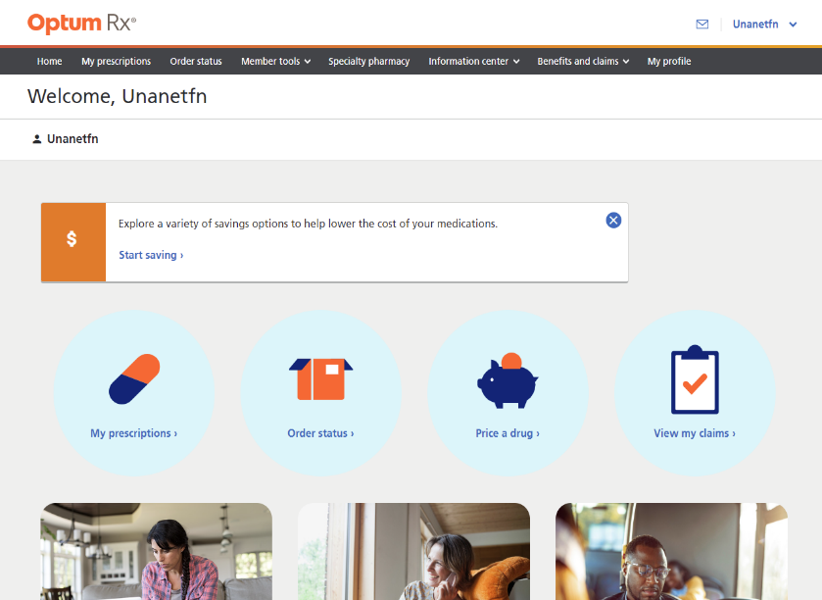
Online Tools Available When Members Need Them
Scan for
Member Portal Demo Video
View benefits and claim history in real time
Transfer prescriptions to mail order
Search for drug pricing and lower cost alternatives
View your mail order status and claim history
Refill and renew mail pharmacy prescriptions
Sign up for medication reminders

Slide 26

eMoney Plan Insights
26
CONFIDENTIAL ©2026 SlateRx

Slide 27
PPO Plan*
COPAYS/COINSURANCE
Non-Specialty Meds | TIER 1 | TIER 2 | TIER 3
Retail (Per 30 Day supply) | $10 | $20 | $35
Retail90 (Per fill) | $20 | $40 | $70
Mail (1-30 Days) | $10 | $20 | $35
Mail (31-90 Days) | $20 | $40 | $70
HDHP Preventive Drug List Meds Brand & Generic | TIER 1 | TIER 2 | TIER 3
Retail (Per 30 Day supply) | $20 | $40 | $60
Retail90 (Per fill) | $40 | $80 | $120
Mail (1-30 Days) | $20 | $40 | $60
Mail (31-90 Days) | $40 | $80 | $120
Specialty Meds | TIER 1 | TIER 2 | TIER 3
Retail (Per 30 Day supply) | $10 | $20 | $35
*Deductible does not apply to pharmacy benefit

Slide 28
HDHP Plan
COPAYS/COINSURANCE
Non-Specialty Meds | TIER 1 | TIER 2 | TIER 3
Retail (Per 30 Day supply) | $20 | $40 | $60
Retail90 (Per fill) | $40 | $80 | $120
Mail (1-30 Days) | $20 | $40 | $60
Mail (31-90 Days) | $40 | $80 | $120
HDHP Preventive Drug List Meds Brand & Generic | TIER 1 | TIER 2 | TIER 3
Retail (Per 30 Day supply) | $20 | $40 | $60
Retail90 (Per fill) | $40 | $80 | $120
Mail (1-30 Days) | $20 | $40 | $60
Mail (31-90 Days) | $40 | $80 | $120
Specialty Meds | TIER 1 | TIER 2 | TIER 3
Retail (Per 30 Day supply) | $20 | $40 | $60
DEDUCTIBLE | INDIVIDUAL ($$) | FAMILY ($$)
Combined Medical / Rx | $2,000 | $4,000

Slide 29

Questions / Thank you

