Slide 1
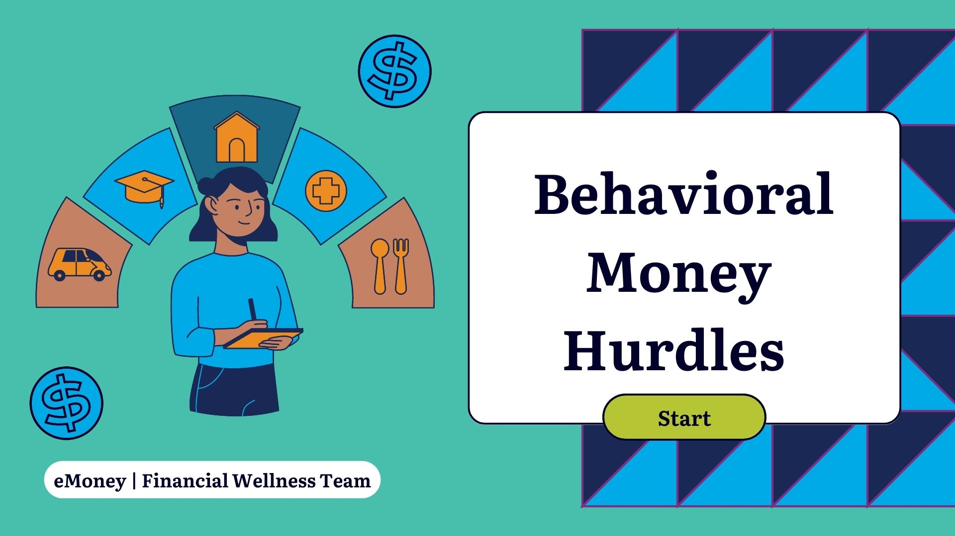

Slide 2
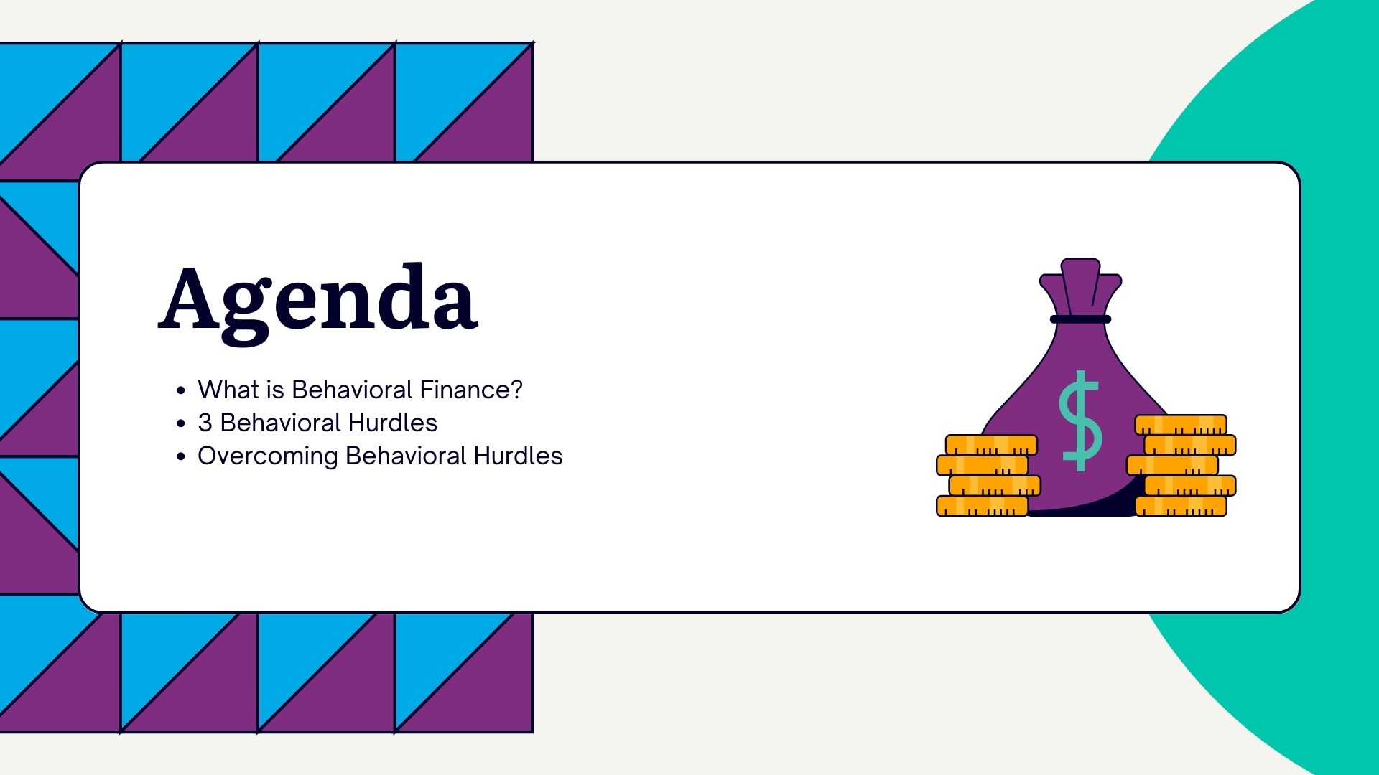

Slide 3


Slide 4
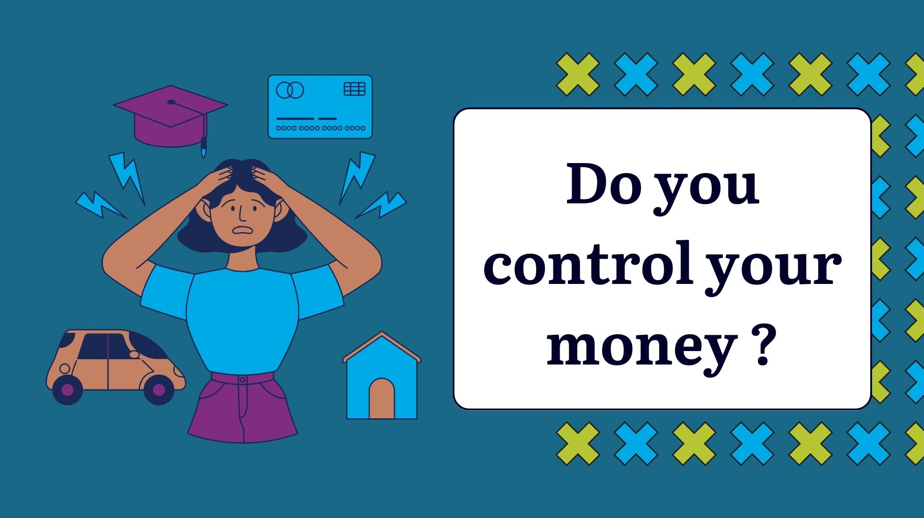

Slide 5
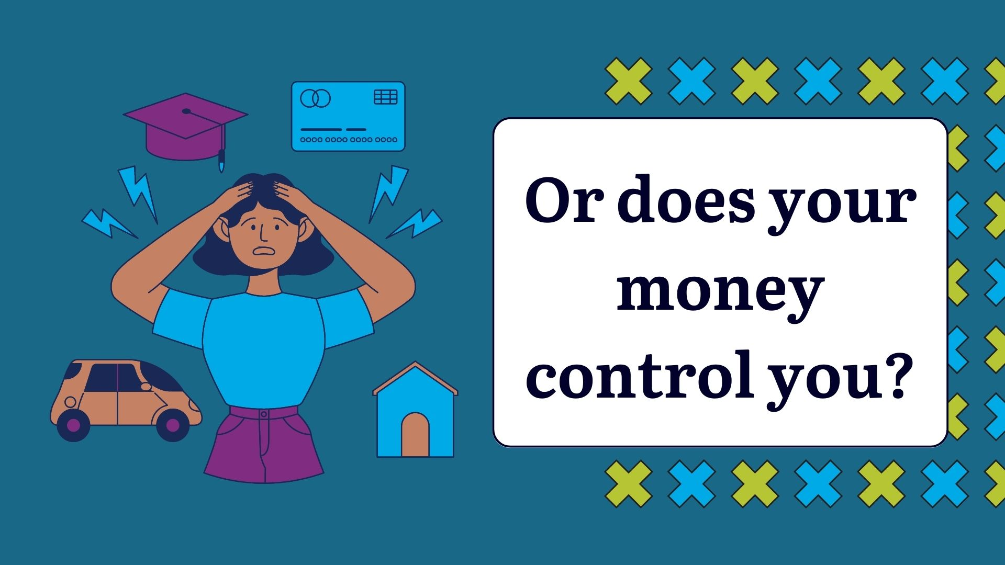

Slide 6
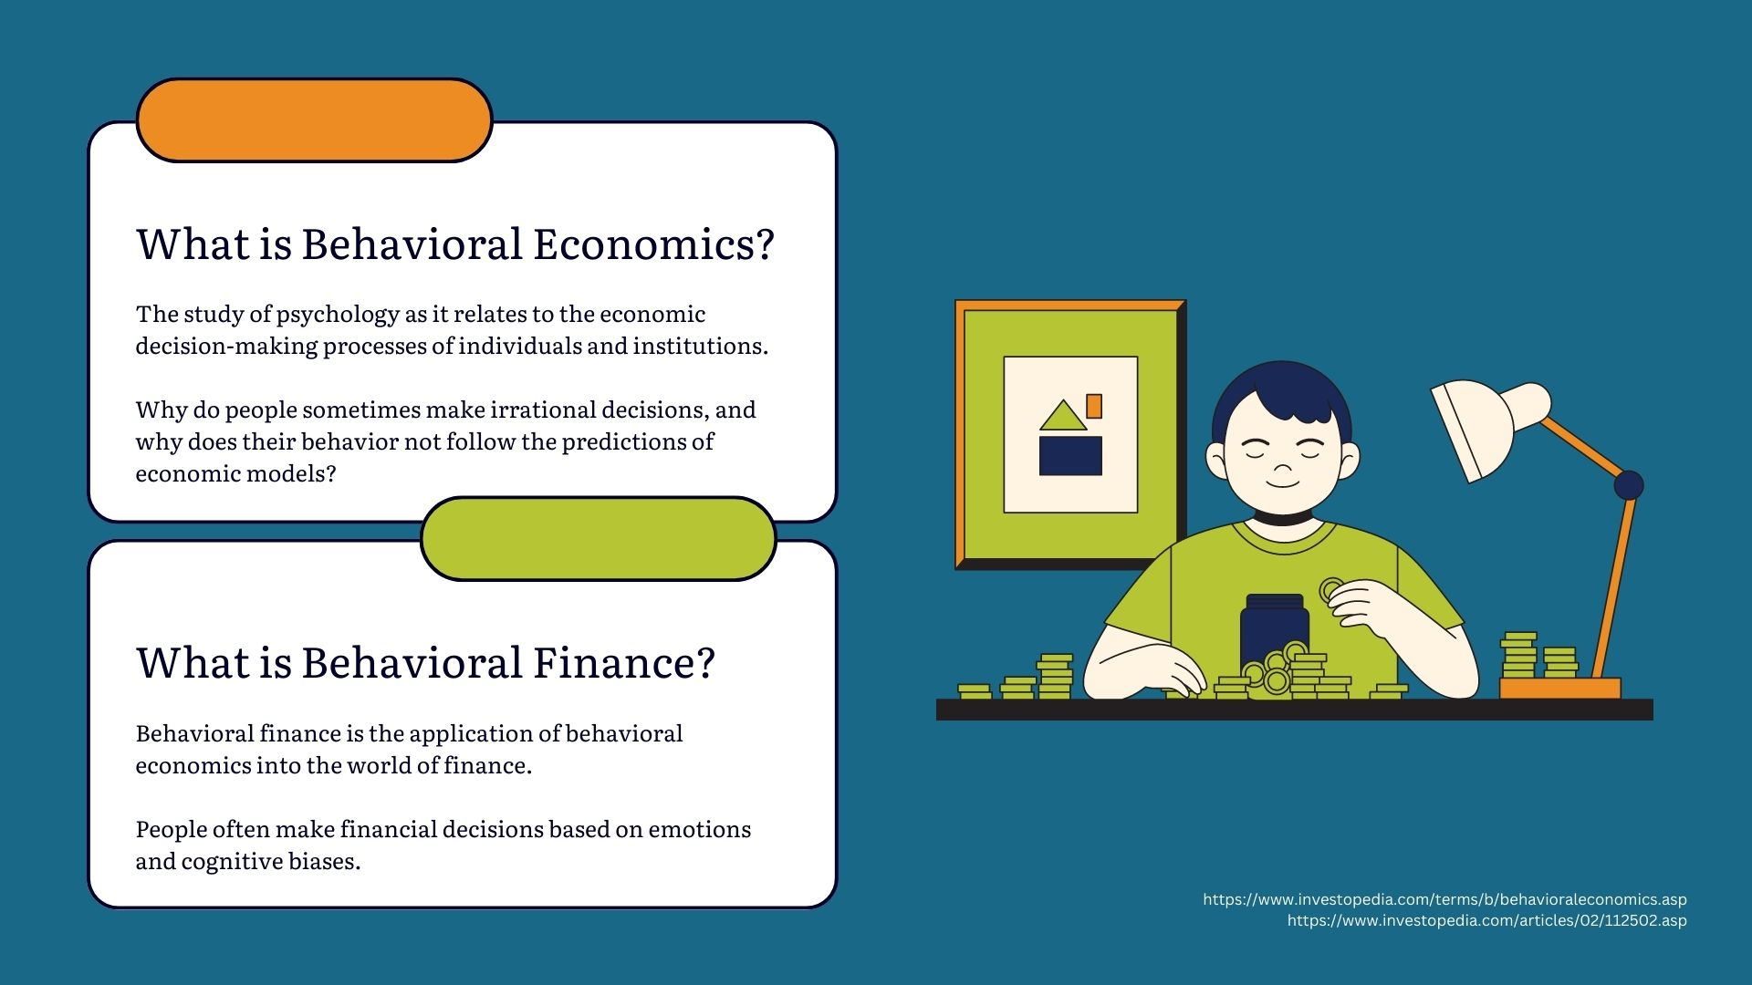
Notes:
Sasha Start
I always like to start with a baseline of definitions to get us started, that way we’re all on the same page. My love of behavioral economics started in college. Economics really is the study of when X does this, then Y does that. In real life we know that money is influenced by lots of other factors and sometimes we make decisions that are rational to us, but seem irrational to others.
Behavioral economics is the umbrella above behavioral finance. It’s more focused on the financial side of decision making.

Slide 7
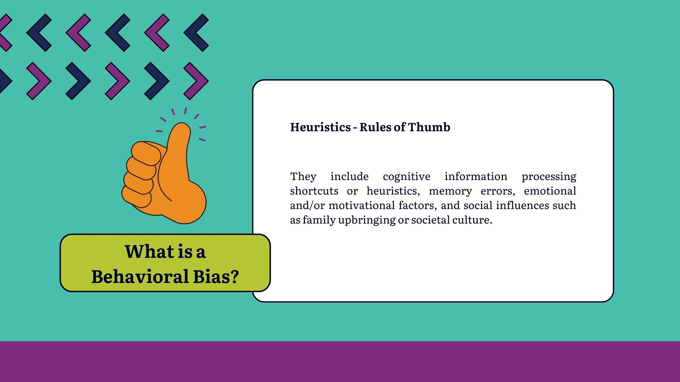
Notes:
Today we’re going to focus on 3 behavioral biases that you may or may not be aware of that could be impacting you long-term. This could be with your money, health, or even your family. While we’re focusing on money today, begin to think about how these biases impact other areas of your life too!
So, a behavioral bias is a way our brains processes information. We create a heuristic or rule of thumb about about a situation or idea using shortcuts, errors we’ve learned, emotional or motivational factors, and social influences. We don’t have much time, so let’s dive in!

Slide 8
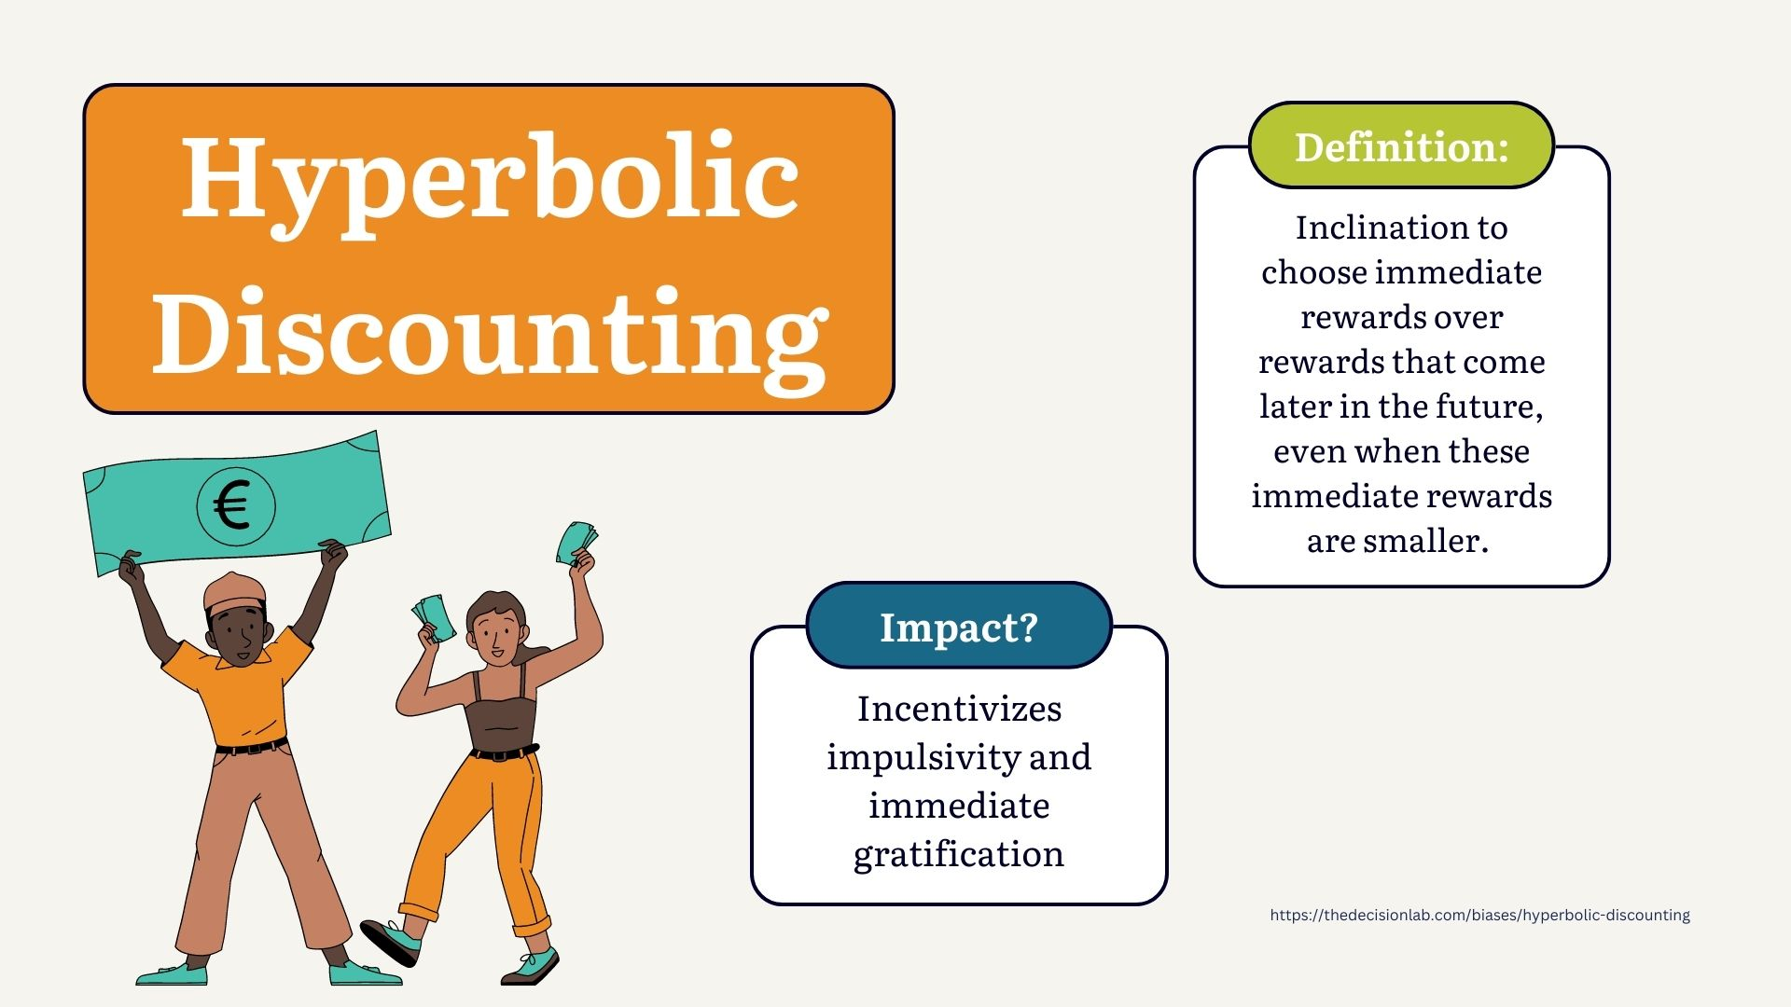
Notes:
Hyperbolic discounting is the bias of choosing immediate rewards over rewards that come later. A great example I can give you is – going to an experience like Chuck E. Cheese where you can win tickets for prizes. Are you willing to wait months of even years to win the 1,000 ticketed big fluffy cat or cool skateboard or do you want the 20 ticketed stickyman, bouncyball, and gum you can afford and walk out with today?
Why does this happen?
We like a sure thing – and waiting is difficult
EX: Sasha buying a house

Slide 9
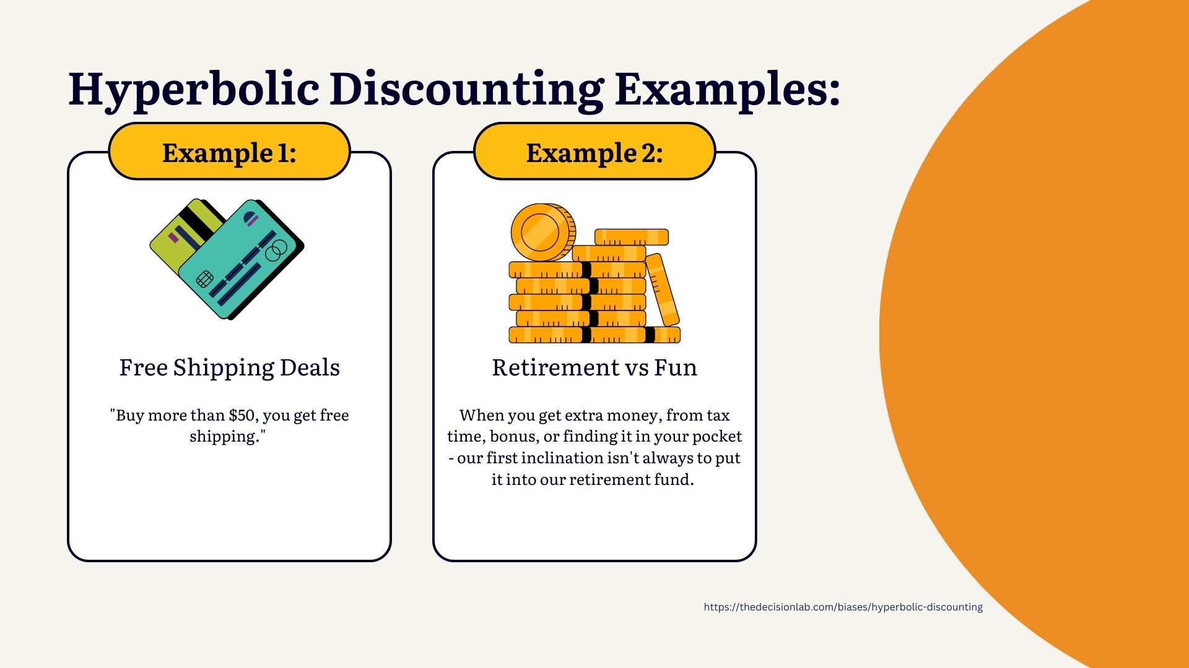
Notes:
Here are a few other examples

Slide 10
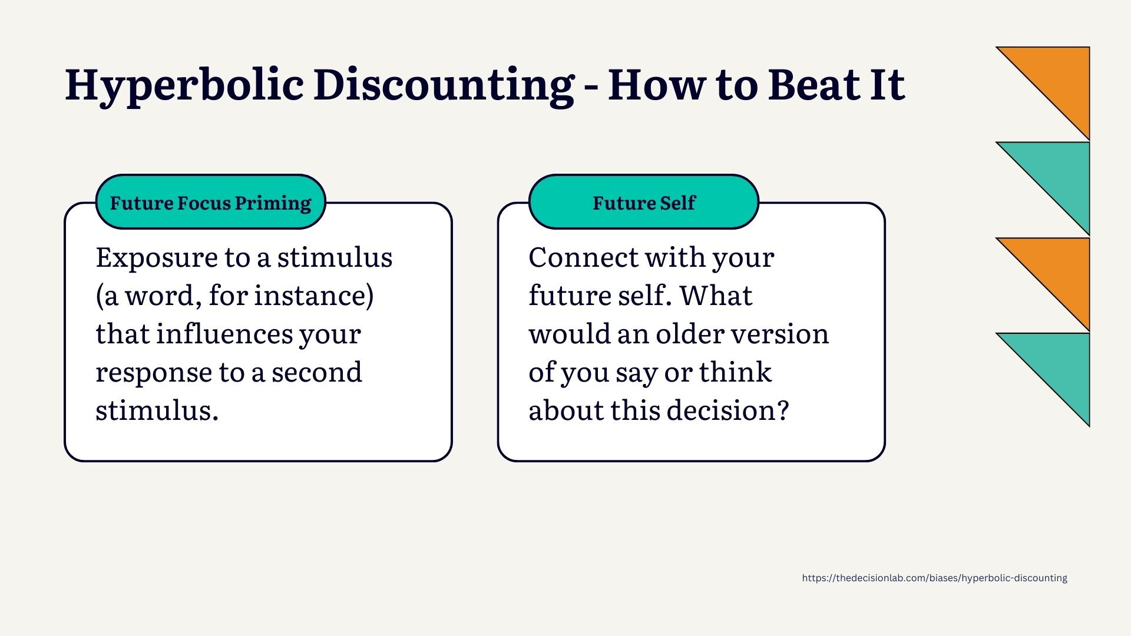
Notes:
Future focus priming ---
A 2016 study concluded that “future focus priming” was an effective way of reducing this cognitive bias. Exposure to words like “future”, “long-term”, and “self-control” – actually made participants more likely to think of themselves and their future in this way. Thinking about and discussing your long-term future on a regular basis may “prime” you for making decisions that prioritize it.

Slide 11
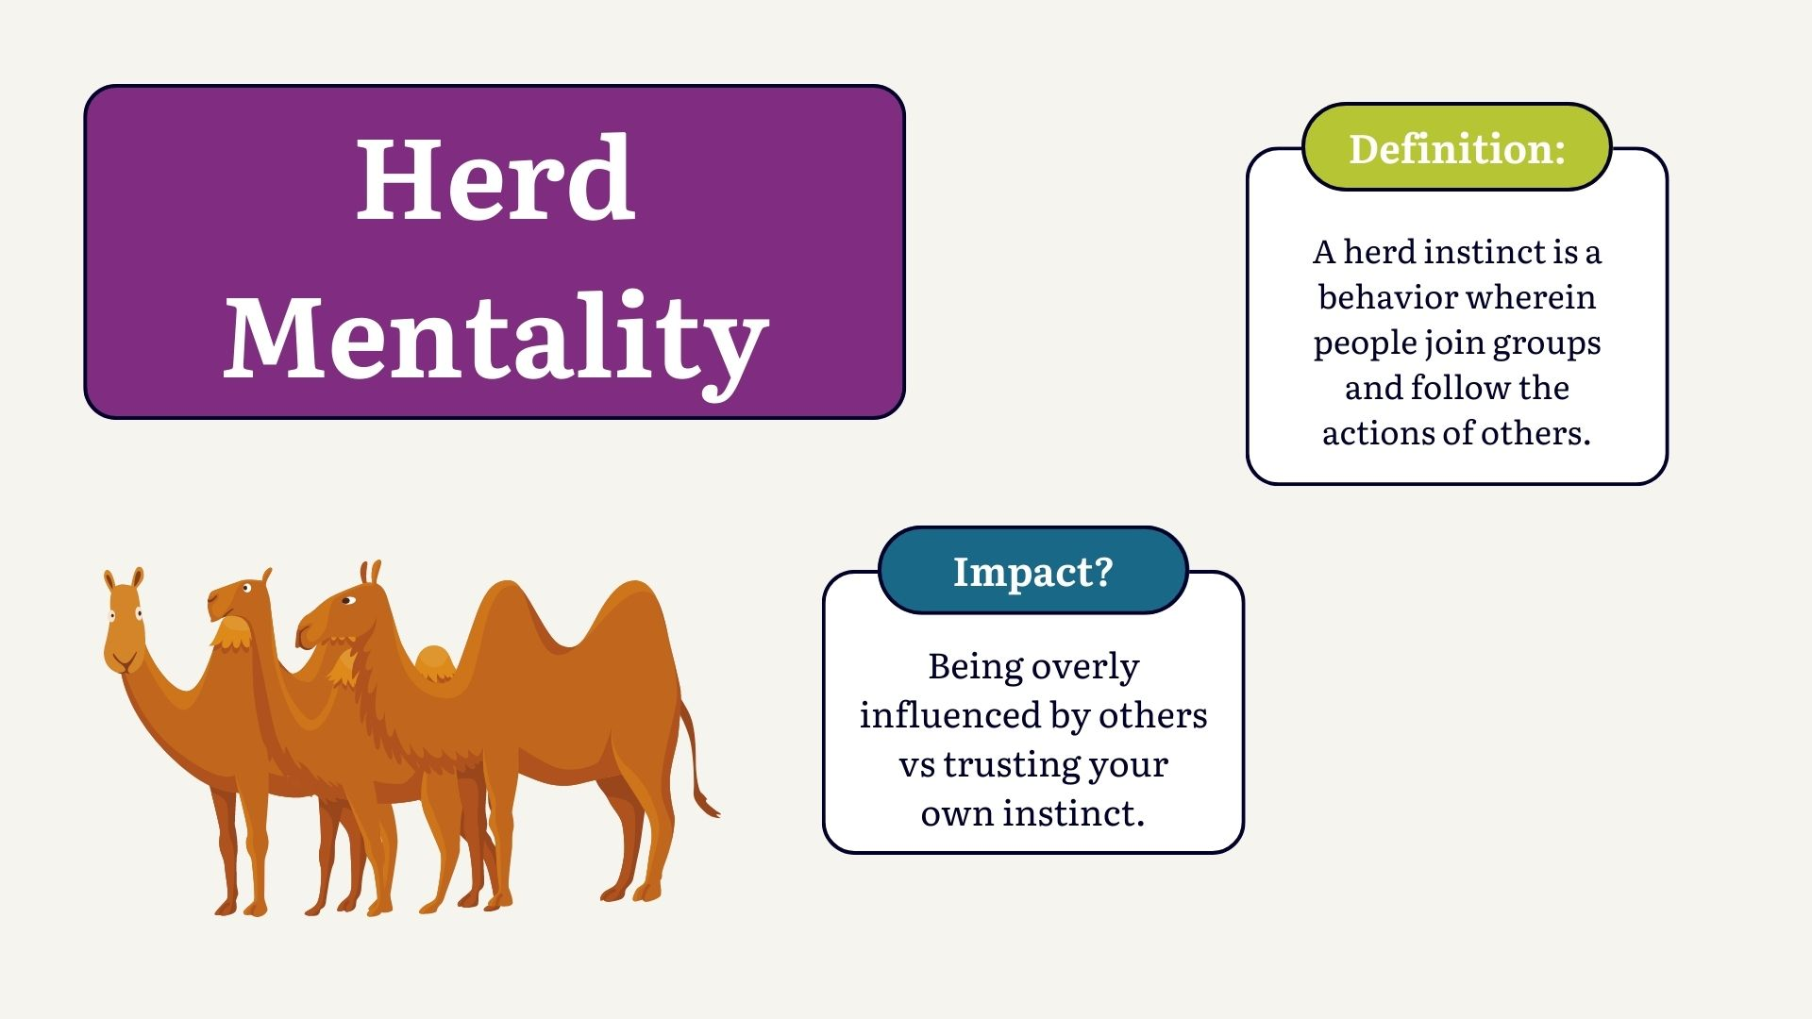
Notes:
Arleny Start

Slide 12
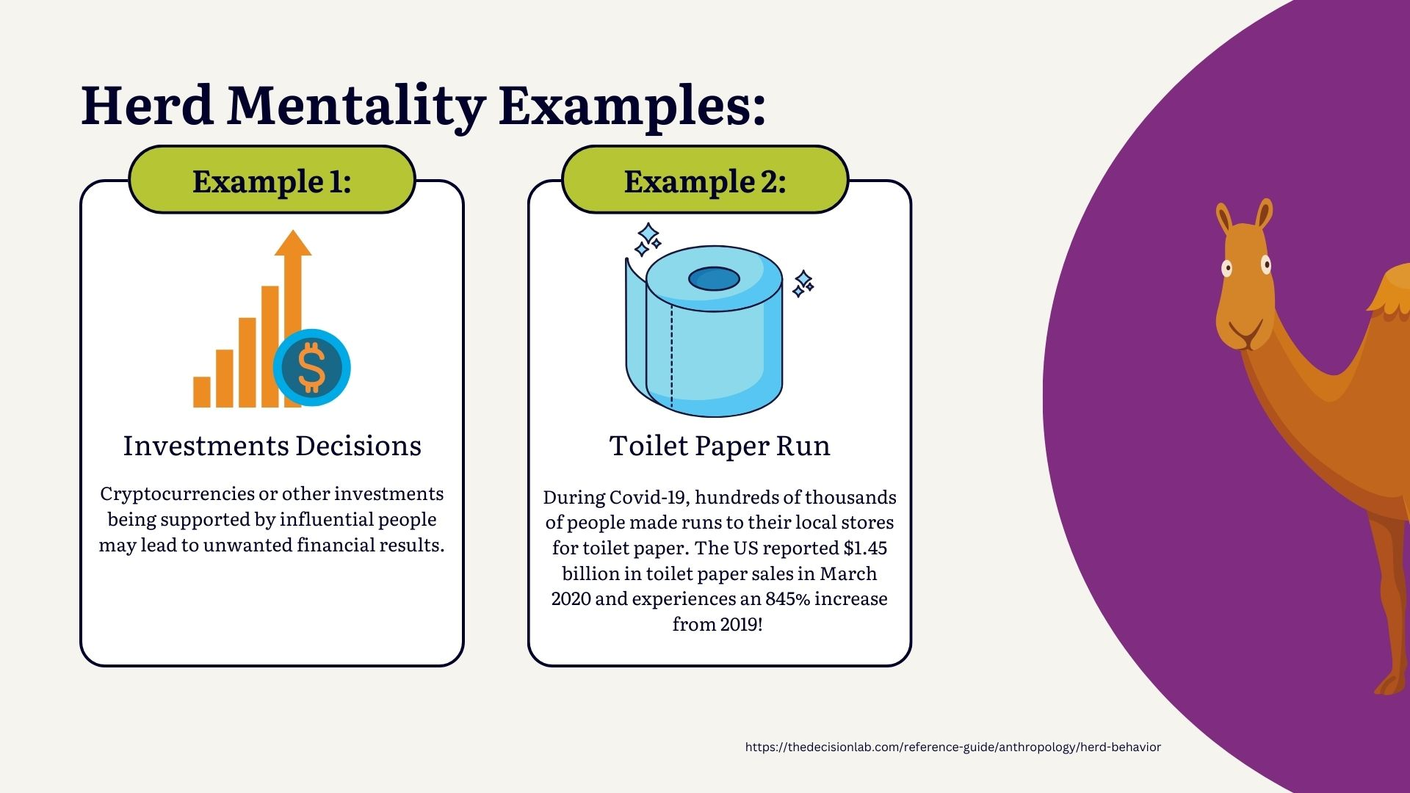
Notes:
https://www.chron.com/business/article/Toilet-paper-demand-shot-up-845-during-the-15405214.php

Slide 13
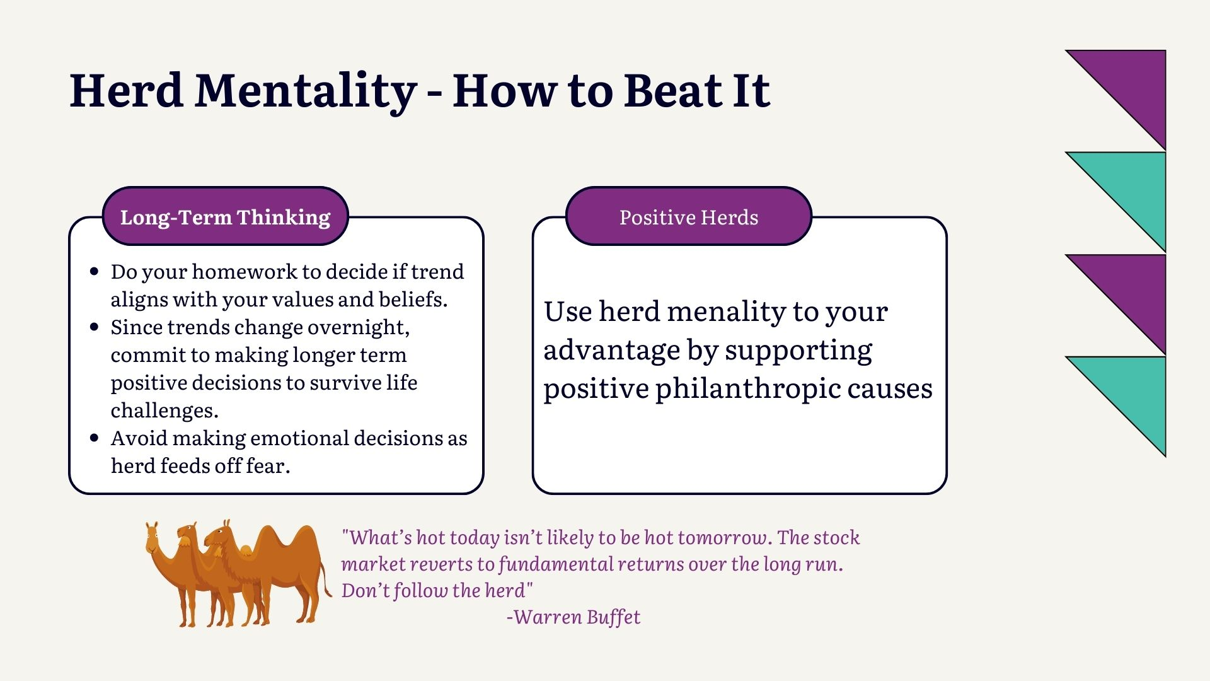

Notes:
Positive herds – the ALS ice bucket challenge. The Ice Bucket Challenge generated $115 million for the national office of the ALS Assocation in 2014.
https://www.als.org/blog/understanding-impact-ice-bucket-challenge-als-associations-finances

Slide 14
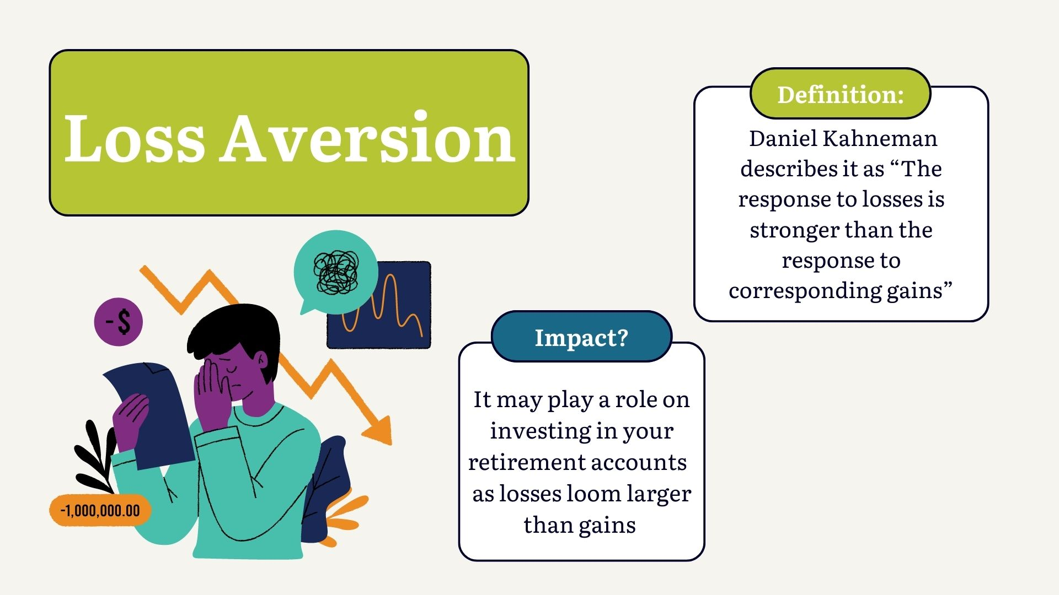
Notes:
Loss aversion is a cognitive bias that describes why, for individuals, the pain of losing is psychologically twice as powerful as the pleasure of gaining. The loss felt from money, or any other valuable object, can feel worse than gaining that same thing.¹

Slide 15
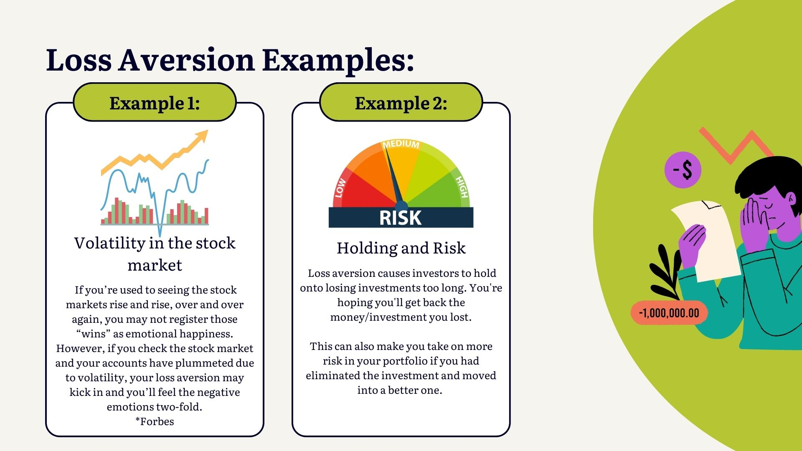
Notes:
This is often said because many individuals become hyper-focused on investments that lose money while ignoring investment decisions that make money.

Slide 16
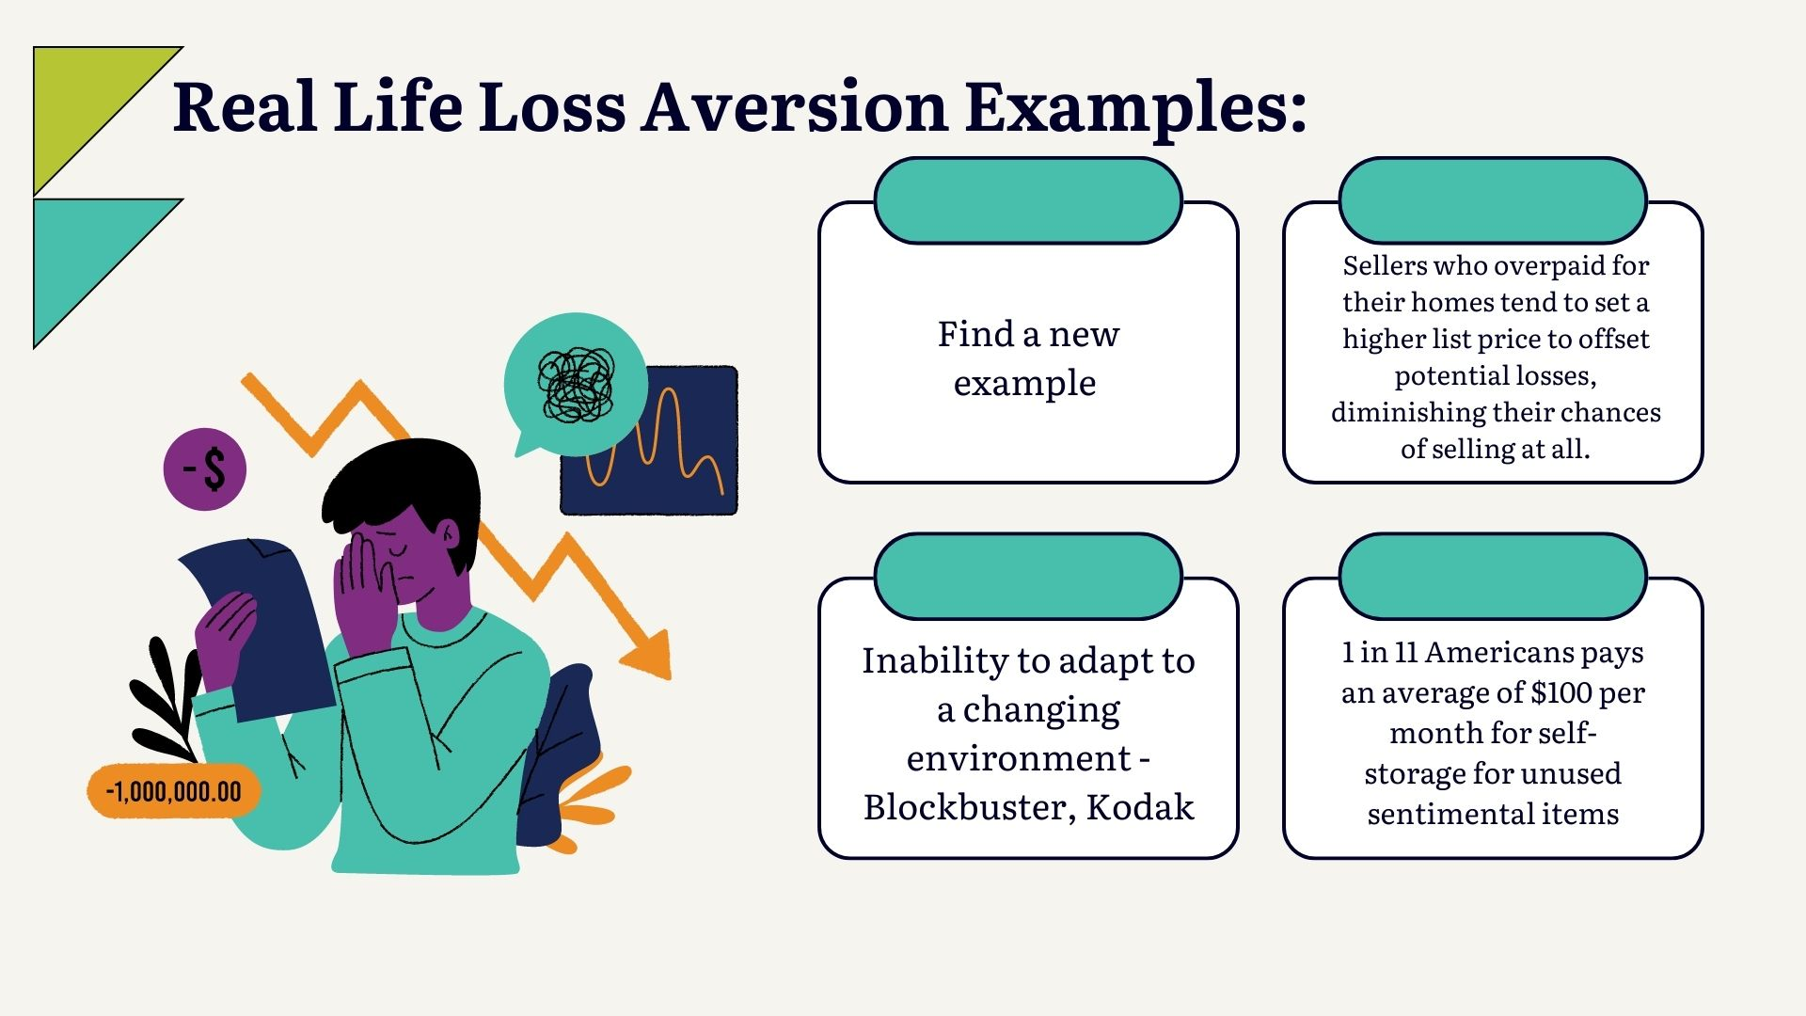
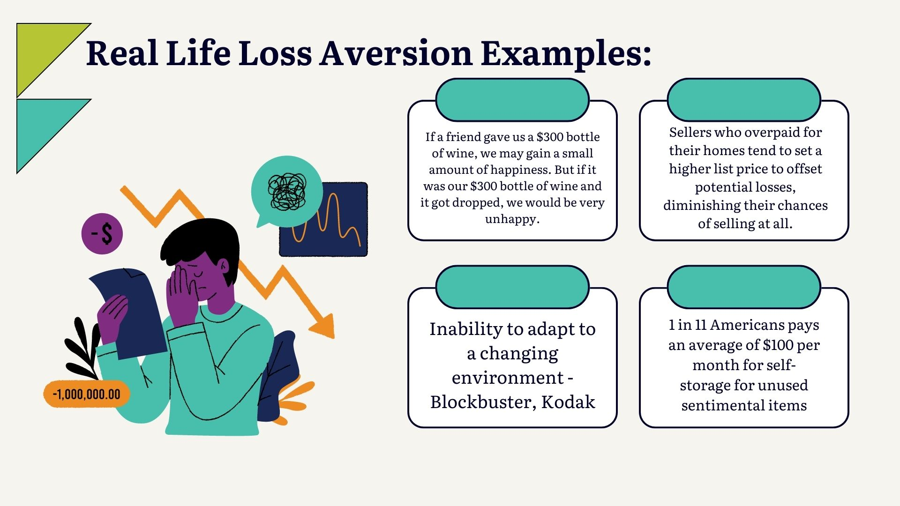

Slide 17
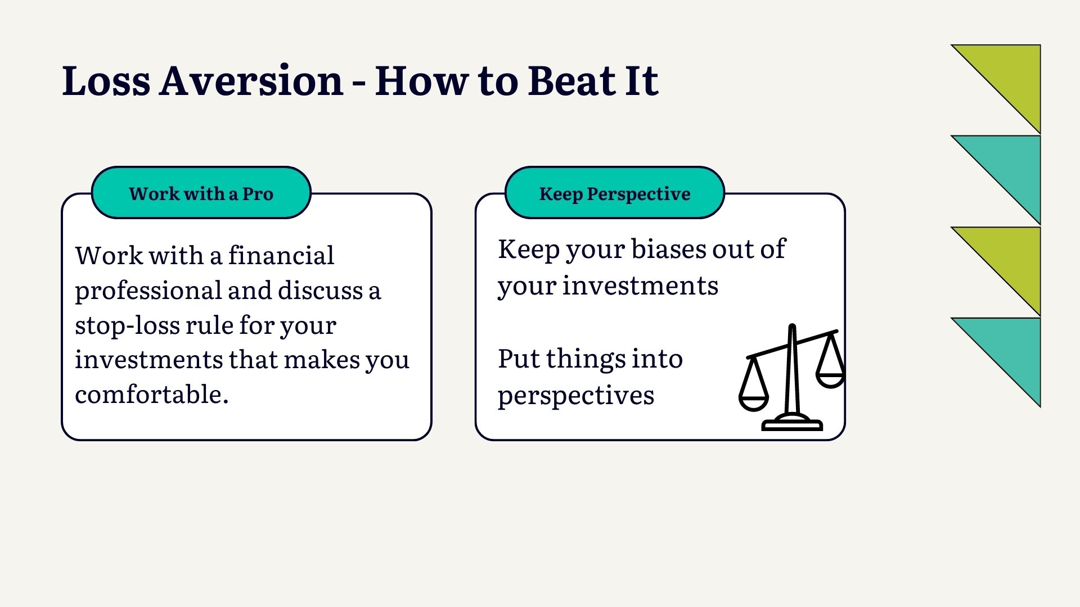

Slide 18
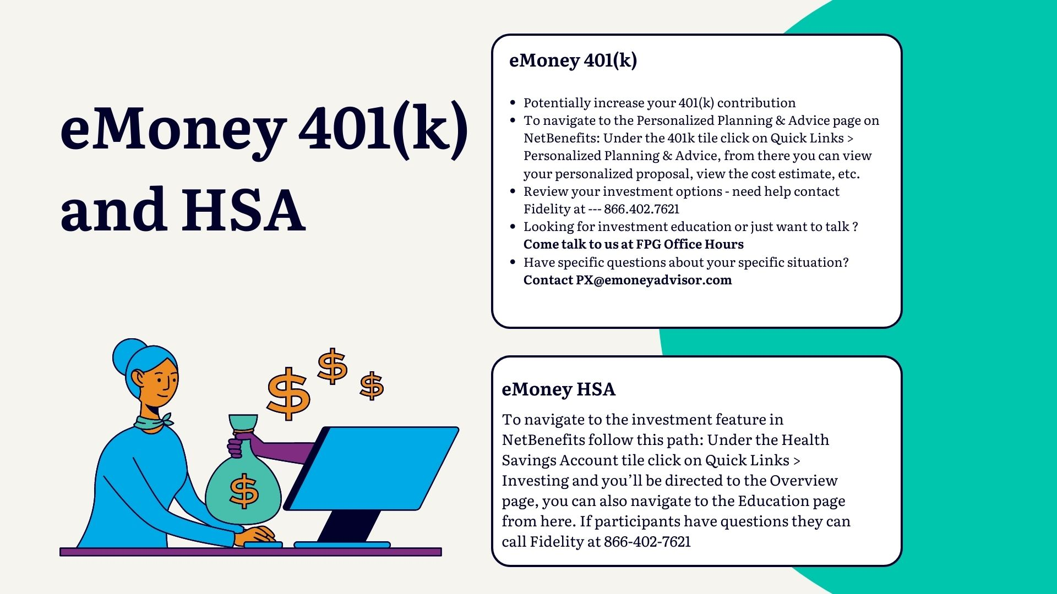
Notes:
Arleny Start

Slide 19
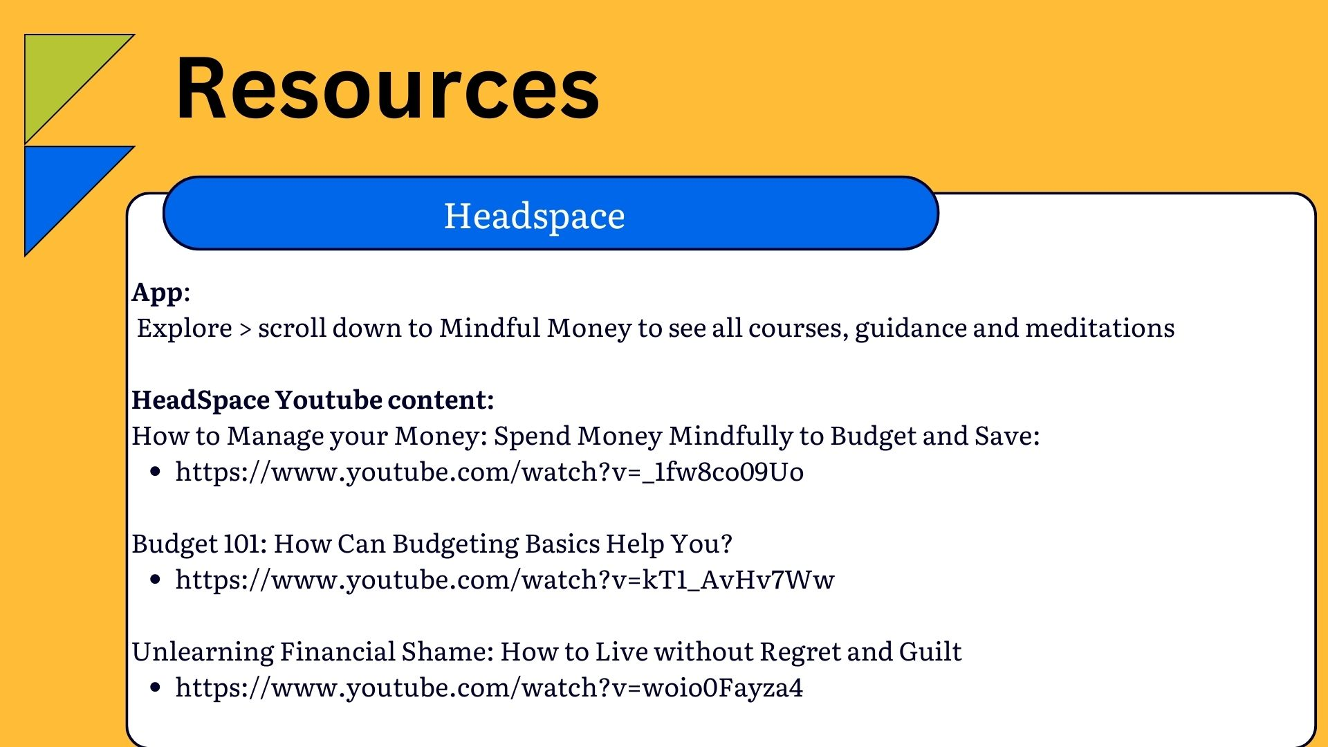
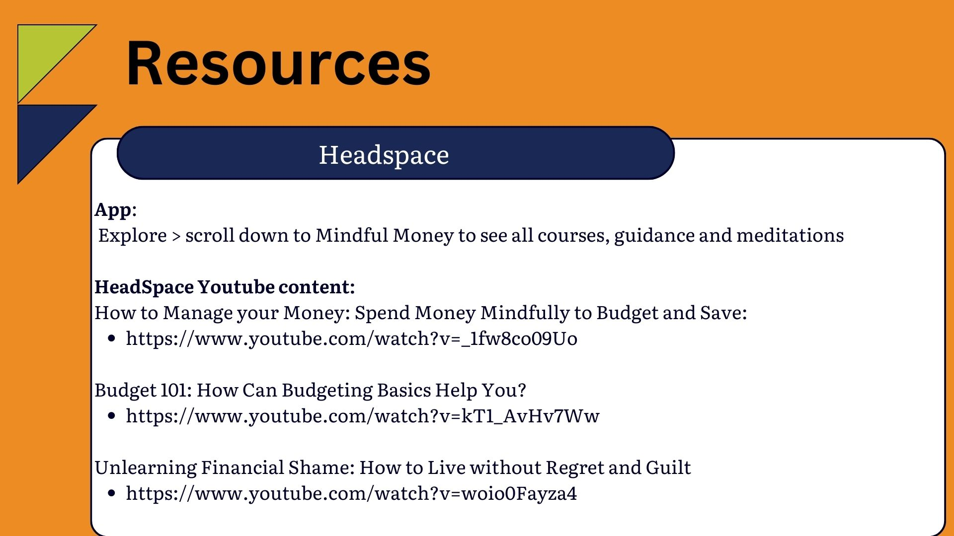

Slide 20
