Slide 1
Total Rewards Lunch & Learn
Presented by Jennifer Aldridge, Stephanie Starr & Elizabeth Tucker
October 27, 2022

Slide 2

Total Rewards Lunch & Learn
Presented by Jennifer Aldridge, Stephanie Starr & Elizabeth Tucker
October 27, 2022

Slide 3
Total Rewards Lunch & Learn
Presented by Jennifer Aldridge, Stephanie Starr & Elizabeth Tucker
October 27, 2022

Slide 4
What is Total Rewards?
At eMoney, Total Rewards falls under the People Experience team and is broken down into three groups:
  Compensation
  Benefits & Wellness
  Rewards & Recognition
eMoney’s total rewards philosophy is simple: We believe our employees deserve to be rewarded fairly and competitively in return for their contribution to eMoney’s success.

Slide 5
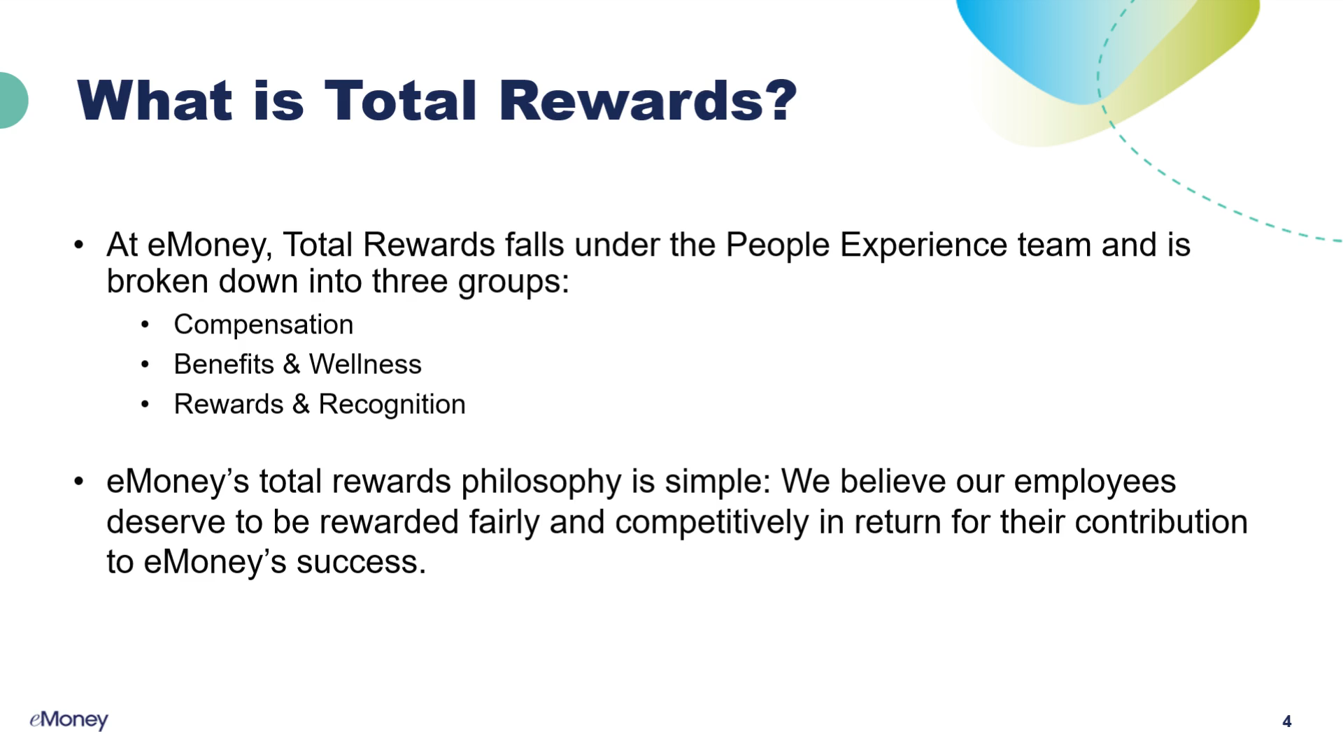
What is Total Rewards?
At eMoney, Total Rewards falls under the People Experience team and is broken down into three groups:
  Compensation
  Benefits & Wellness
  Rewards & Recognition
eMoney’s total rewards philosophy is simple: We believe our employees deserve to be rewarded fairly and competitively in return for their contribution to eMoney’s success.

Slide 6
Compensation

Slide 7
General Overview
The goal of eMoney's Compensation Philosophy is to offer a transparent, thoughtful policy framework that enables us to make systematic decisions around employee compensation.
At the center of our philosophy, we are a "Pay for Performance" organization
Core compensation initiatives throughout the year include:
  Merit Increases and Annual Review Process
  Bonus Payments
  Market Adjustments
  Quarterly Promotions
Notes:
Over the next few slides we are going to review some of our core initiatives from throughout the year that help us to ensure eMoney is competitive to the market and we are living by our Total Rewards and Compensation philosophies.

Slide 8
Types of Compensation
How is each type determined
Base Pay
Market Data
Performance
Experience
Variable Pay
Company Performance
Individual Performance
Hourly/Annual Rate
Bonus/Commission
Position
Notes:
eMoney believes in emphasizing a strong pay for performance perspective in each employee’s total rewards package through based pay and variable pay programs.

Slide 9
Merit Increases
What is a merit increase?
  A merit increase is a base pay increase which is directly tied to the employee's performance.
When are merit increases given?
  Merit increases are given once per year during the Annual Review Process and are effective March 1st.
Who is eligible for a merit increase?
  All full-time and part-time eMoney employees are eligible for a merit increase unless hired on or after November 1st

Slide 10
Annual Review Cycle
Merit increases align with eMoney’s Annual Performance Management Cycle
Once managers rate the performance of their employees, the company wide compensation review is conducted from mid-January through the end of February.
We utilize our overall compensation philosophy and calibrate across the organization based on:
  Performance
  Market data range
  Time in role
  Experience and skill set
  Internal Equity

Slide 11
Bonus Payments
When are bonuses paid?
  Bonuses are paid in mid-March for the previous year's bonus plan year.
Who is NOT eligible for a bonus payment?
  Employees hired on/after October 1st
  Part-time employees that are not eligible for eMoney's benefits plan
  Employees on a commission plan
  Anyone on an active Performance Improvement Plan
How are bonuses calculated?
$5,000
Individual Goal Attainment
Bonus Payout
Company Funding
Bonus Target
Base Salary
100%
$5,000
100%
10%
$50,000

Slide 12
Market Adjustments
What is a market adjustment?
    A market adjustment is a base pay increase which is directly tied to the competitive market data for a job.
How often are employees reviewed for market adjustments?
    Market data is refreshed and reviewed twice per year (January and July) to ensure eMoney is paying competitive rates according to any shifts in the market.
How do we determine if a market adjustment is needed?
    If the market data shifts up, it could result in an employee receiving a market adjustment to keep their compensation competitive with the external market.
  What is the process for giving a market adjustment?
    Compensation will reach out to the employee's manager with a recommendation

Slide 13
Promotions
Promotions are submitted and reviewed on a quarterly basis
Managers need to complete the quarterly promo justification form by the 10th of the month prior to each quarterly effective date
To be eligible for a promotion or transfer, an employee must:
  Have worked for eMoney and have been in their current position for at least 9 months (unless otherwise specified by department management);
  Be a solid performer and/or have received a rating of “meets expectations” or higher on the most recent performance review;
  Not currently be on a performance improvement plan or written warning; and
  Meet the minimum requirements for the requested job and be able to perform the essential functions of the position

Slide 14
Promotions
So far in 2022:
  75 promotions
  9 transfers
  12% of employee base
Since October 1, 2019:
  295 promotions
  73 transfers
Of those 295 promotions, 229 are still employed at eMoney (78% retention rate)
Since October 1, 2019
295 Promotions
73 Transfers
368 Internal Moves

Slide 15
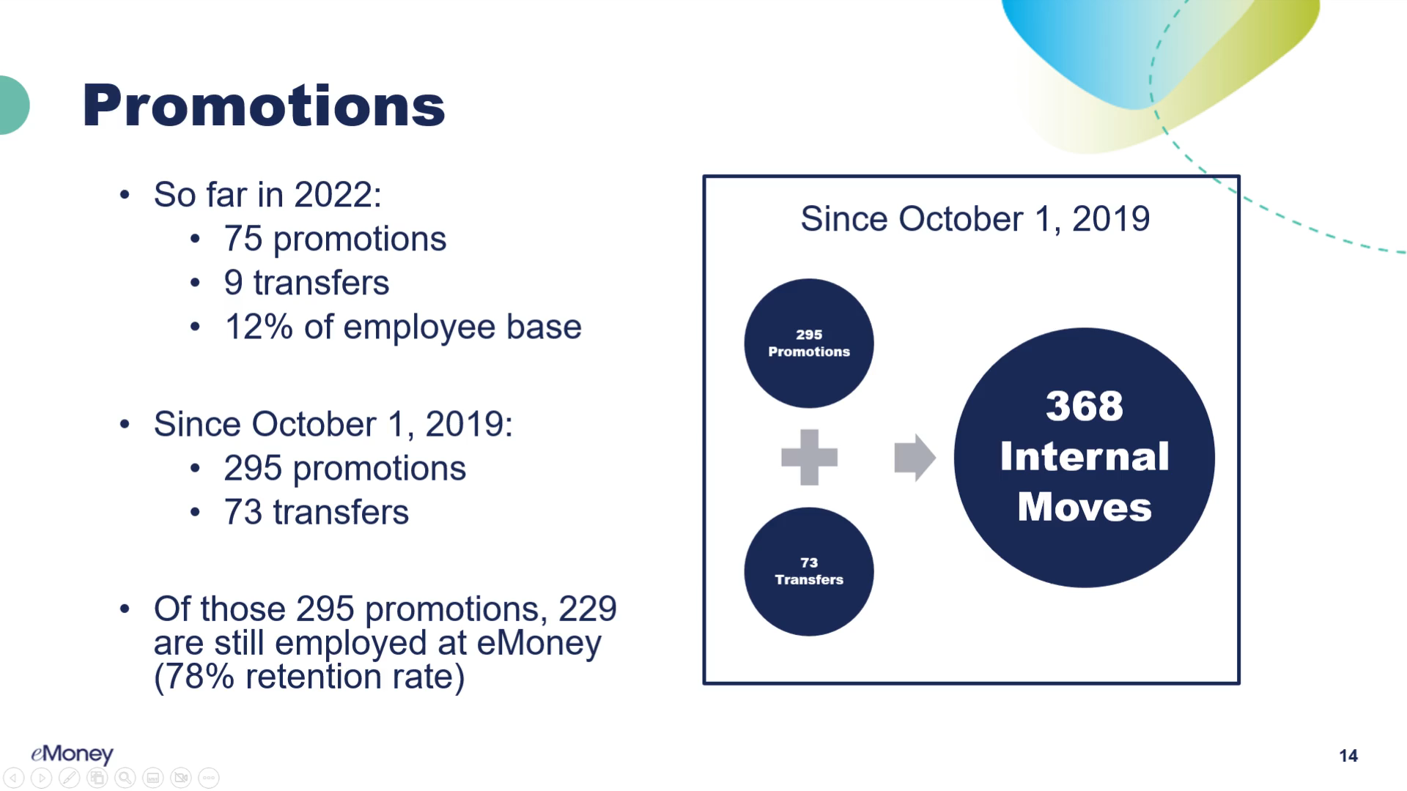
Promotions
So far in 2022:
  75 promotions
  9 transfers
  12% of employee base
Since October 1, 2019:
  295 promotions
  73 transfers
Of those 295 promotions, 229 are still employed at eMoney (78% retention rate)
Since October 1, 2019
295 Promotions
73 Transfers
368 Internal Moves

Slide 16
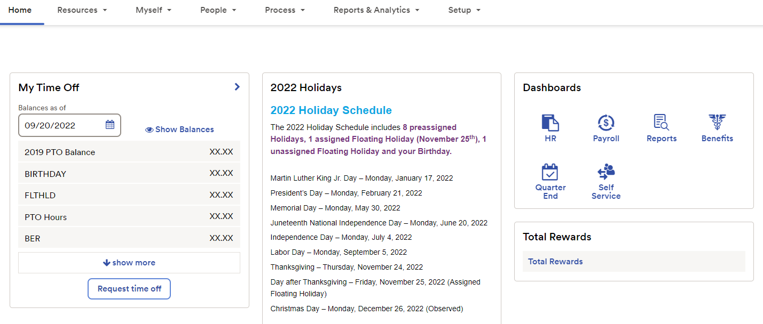
Total Reward Statements
Employees have access to a personalized Total Rewards Statement in ADP

Slide 17
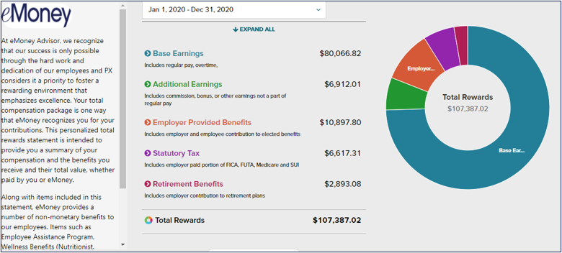
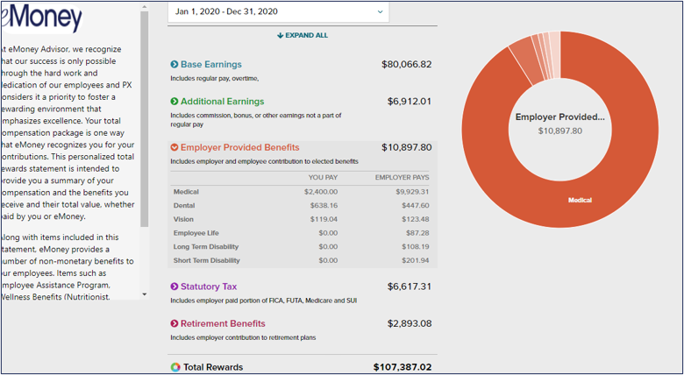
Example:
Each section can be expanded to view detail including employer paid and employee paid portion
Non-monetary benefits are listed in the area on the left, such as Flexible Work Option,
EAP, Wellness Benefits, etc.

Slide 18
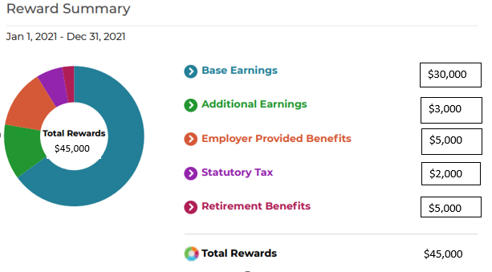
Total Reward Statements
Employees can download the statement and/or print it

Slide 19
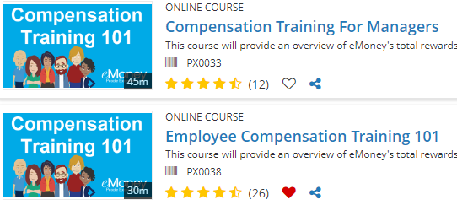

Additional Comp Resources
For more information, please complete Compensation Training 101 in DIG. This course contains a series of animated videos that are each less than 10 minutes long and are designed to help you better understand:
eMoney's Total Rewards Philosophy
Making Pay Decisions (Managers Only)
eMoney's Pay Programs

Slide 20
Benefits & Wellness

Slide 21

Benefits & Wellness

Slide 22
Benefits & Wellness at eMoney!
At eMoney, we are proud to offer our employees a robust and comprehensive benefits package – allowing employees to focus on what really matters to them.
We offer a generous health & welfare package which includes:
Medical – No employee cost option for high deductible plan; Aetna OA MC option available
Health Savings Account (HSA) – Company will seed account; individual plan will receive $900/year, family plan will receive $1,200/year (HDHP only)
Flexible Savings Account (FSA)
Dental – Value and enhanced plans available
Vision – Value and enhanced plans available

Slide 23
Additional Company-Provided Benefits
Flexible Work Allowance - $600/annually per employee
Life Insurance – 1.5x your basic annual earnings, up to a maximum of $250,000
Identity Theft Protection
Emergency Travel Assistance
Employee Assistance Program (EAP):
    Confidential Emotional Support
    Work-life Solutions
    Legal Guidance
    Financial Resources
    Online Support
    Help for New Parents
    Free Online Will Preparation

Slide 24
Need Time Away from Work…?
Short-term and Long-term Disability
FMLA - Family Medical Leave
Paid Parental Leave ( PPL) - eMoney offers benefits eligible employees 4 weeks of 100% paid leave when welcoming a new child to their family
  Eligible employees need to have worked at eMoney for at least one continuous year to take advantage of this benefit
  PPL runs concurrently with the Family and Medical Leave Act (FMLA)
  Policy applies to parental (maternity/paternity), adoption, foster care placement, surrogacy

Slide 25

Headspace
All benefits eligible employees are eligible to enroll in Headspace free of charge
Headspace is an excellent resource for meditations, but they also offer guides for better sleep, workouts & guided cardio, and music to help you focus

Slide 26
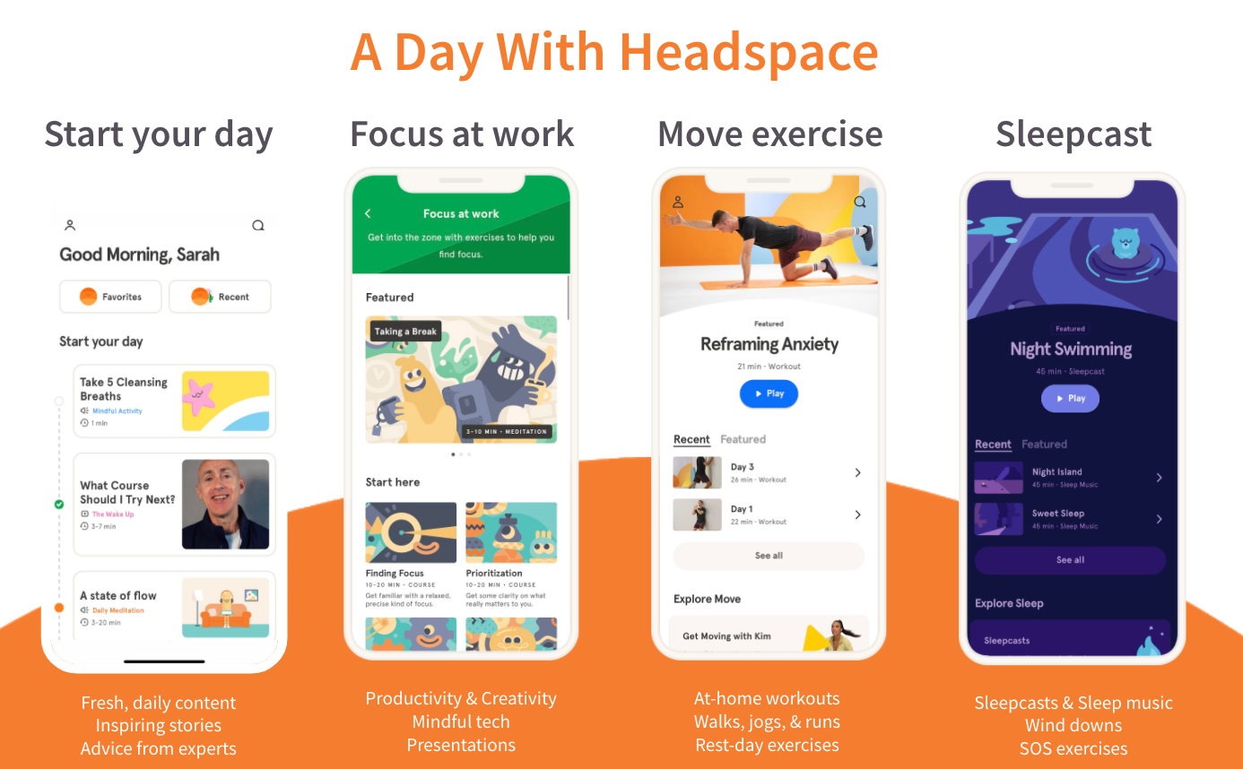
Headspace

Slide 27
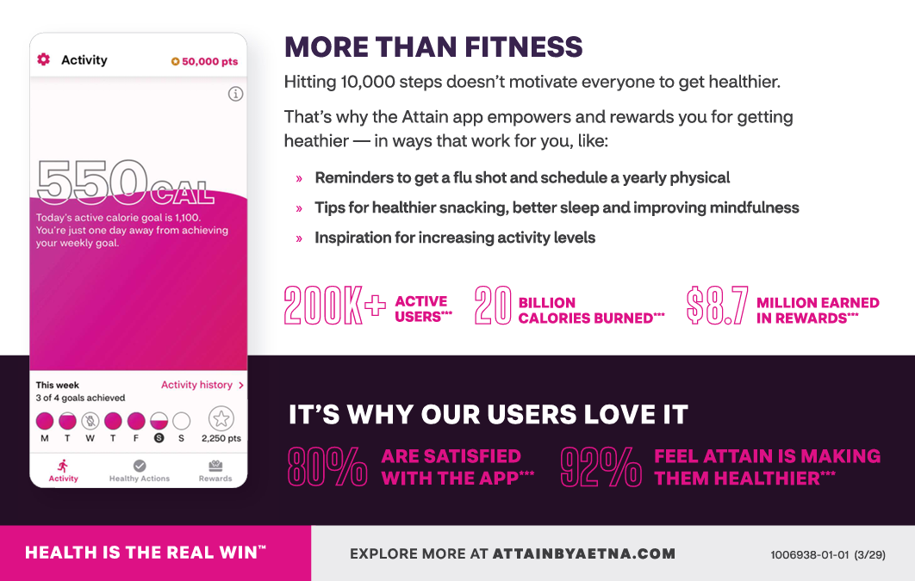
Attain by Aetna
Attain by Aetna helps you follow your own path to better health. The app takes your unique health history, combines it with your wearable device activity and offers personalized goals, achievable actions and motivating rewards.
How it works:
  Download the Attain by Aetna app
    Order your apple watch or select to earn gift cards
  Stay active – hit personalized daily and weekly activity goals
  Take health actions – getting your flu shot, scheduling your annual physical, practicing mindfulness
  Score points & earn rewards – earn points by completing these actions, then redeem for rewards like gift cards or payments towards a new apple watch

Slide 28
Nationwide Pet Insurance
eMoney offers discounted pet insurance through Nationwide
There are two reimbursement levels that you can choose from, 50% or 70%, the rate is dependent upon the type of animal you are covering and their age
For more information visit petsnationwide.com and search for eMoney Advisor

Slide 29
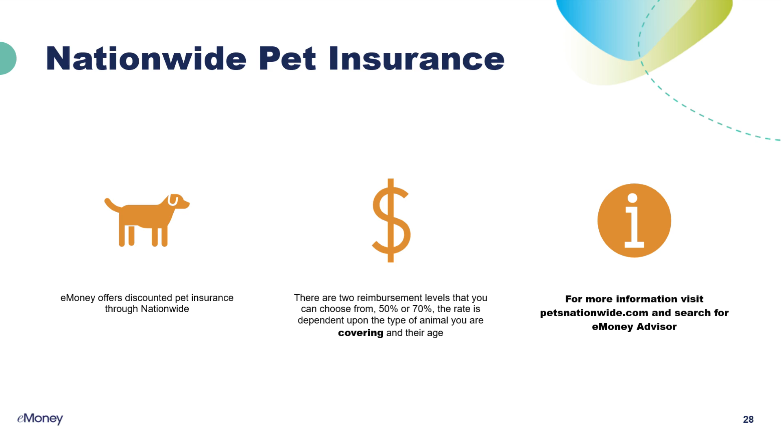
Nationwide Pet Insurance
eMoney offers discounted pet insurance through Nationwide
There are two reimbursement levels that you can choose from, 50% or 70%, the rate is dependent upon the type of animal you are covering and their age
For more information visit petsnationwide.com and search for eMoney Advisor

Slide 30
Educational Assistance Program
eMoney offers all benefits eligible employees the opportunity to further their education by offering the Educational Assistance Program
This program is designed to encourage and provide financial support for our employees to pursue outside studies in order to improve job performance and prepare for advancement opportunities within eMoney
Approved educational assistance applications are eligible for reimbursement of up to 100% of expenses up to a max amount of $5,250 per calendar year
The educational assistance program encompasses any continuing education, defined as:
  A degree or certification program offered by an accredited University or College;
  OR
  Certification requiring a proctored exam and resulting in a nationally-recognized professional certification;
  AND requiring self-study of coursework of 3 or more months
Prior approval must be obtained for educational assistance
The policy and application can be found on ServiceNow

Slide 31
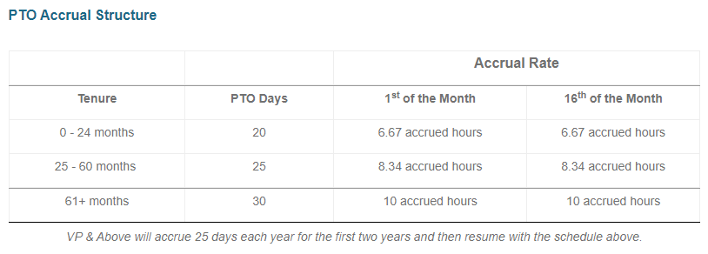
PTO Reminders!
We accrue PTO on 1st and 16th of each month. You must be 'active' in ADP on those days to accrue PTO
  Refer to table below for accrual rates
We are allowed to carryover 40 hours of unused PTO into 2023 and that time must be used by March 31, 2023 ( except CA and NE employees)
As we are now in Q4, please work with your managers and submit your PTO requests ahead of time so we're not all scrambling at the end of the year

Slide 32
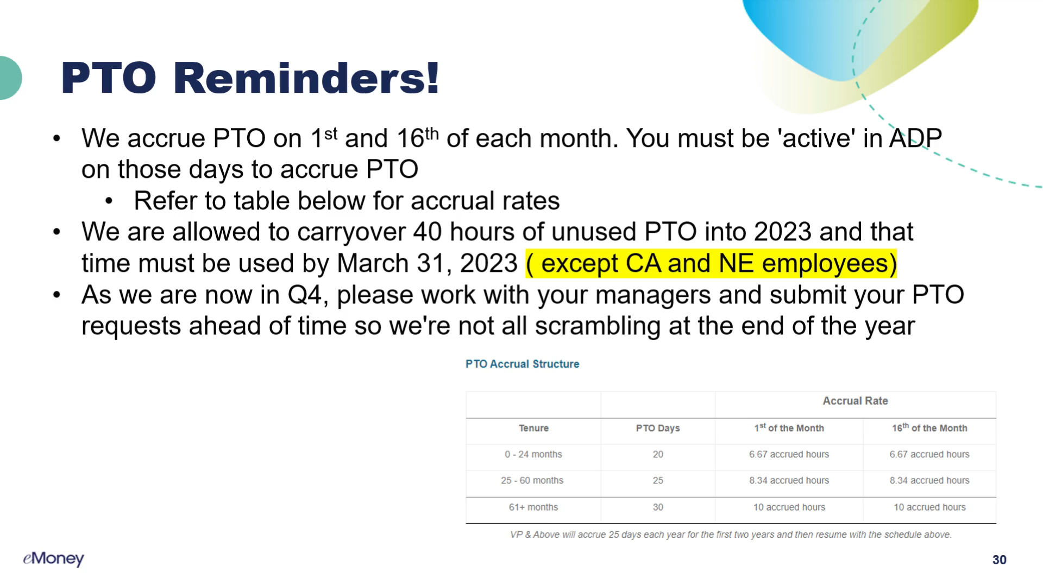
PTO Reminders!
We accrue PTO on 1st and 16th of each month. You must be 'active' in ADP on those days to accrue PTO
  Refer to table below for accrual rates
We are allowed to carryover 40 hours of unused PTO into 2023 and that time must be used by March 31, 2023 ( except CA and NE employees)
As we are now in Q4, please work with your managers and submit your PTO requests ahead of time so we're not all scrambling at the end of the year

Slide 33
Rewards & Recognition

Slide 34

eMpower Program
Rewards & Recognition
eMpower is a tool that eMoney uses for a rewards and recognition program
Points are awarded to employees to recognize them and can be redeemed online for various awards on the eMpower website
Employees are given 50 monthly budget points and managers are given a quarterly budget
  Any unused points expire at the end of the month or quarter
Programs offered are:
  Manager to Employee recognition
  Peer to peer recognition

Slide 35

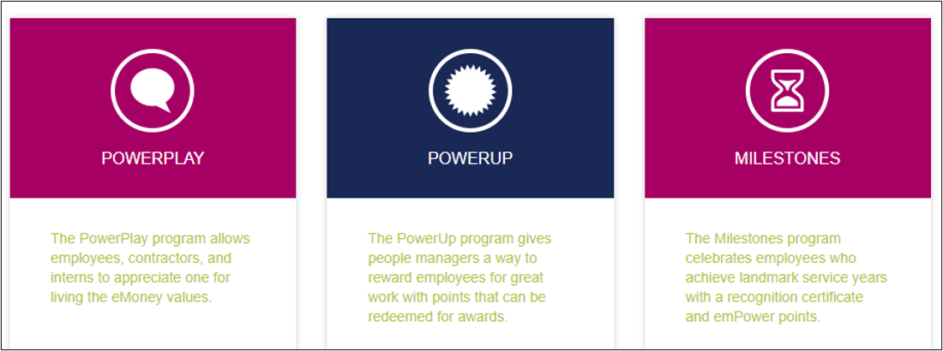
eMpower Points
Ways to Earn Points

Slide 36
Employee Excellence Award
The eMoney Excellence Award (EEA) is our highest recognition for individual or team achievement and is awarded semi-annually.
  This program allows our leadership team to recognize individuals/teams at VP level and below for achievements that surpass the expectations of their roles, and those who have had an impact on our organization’s mission, vision, and/or core values.
All full-time and part-time company employees (up to VP level) are eligible
Notes:
Voice over.... so we know we could go on about these programs and tell you how great they are, BUT... we thought you might like to hear from some of your colleagues directly who were recipients:

Slide 37
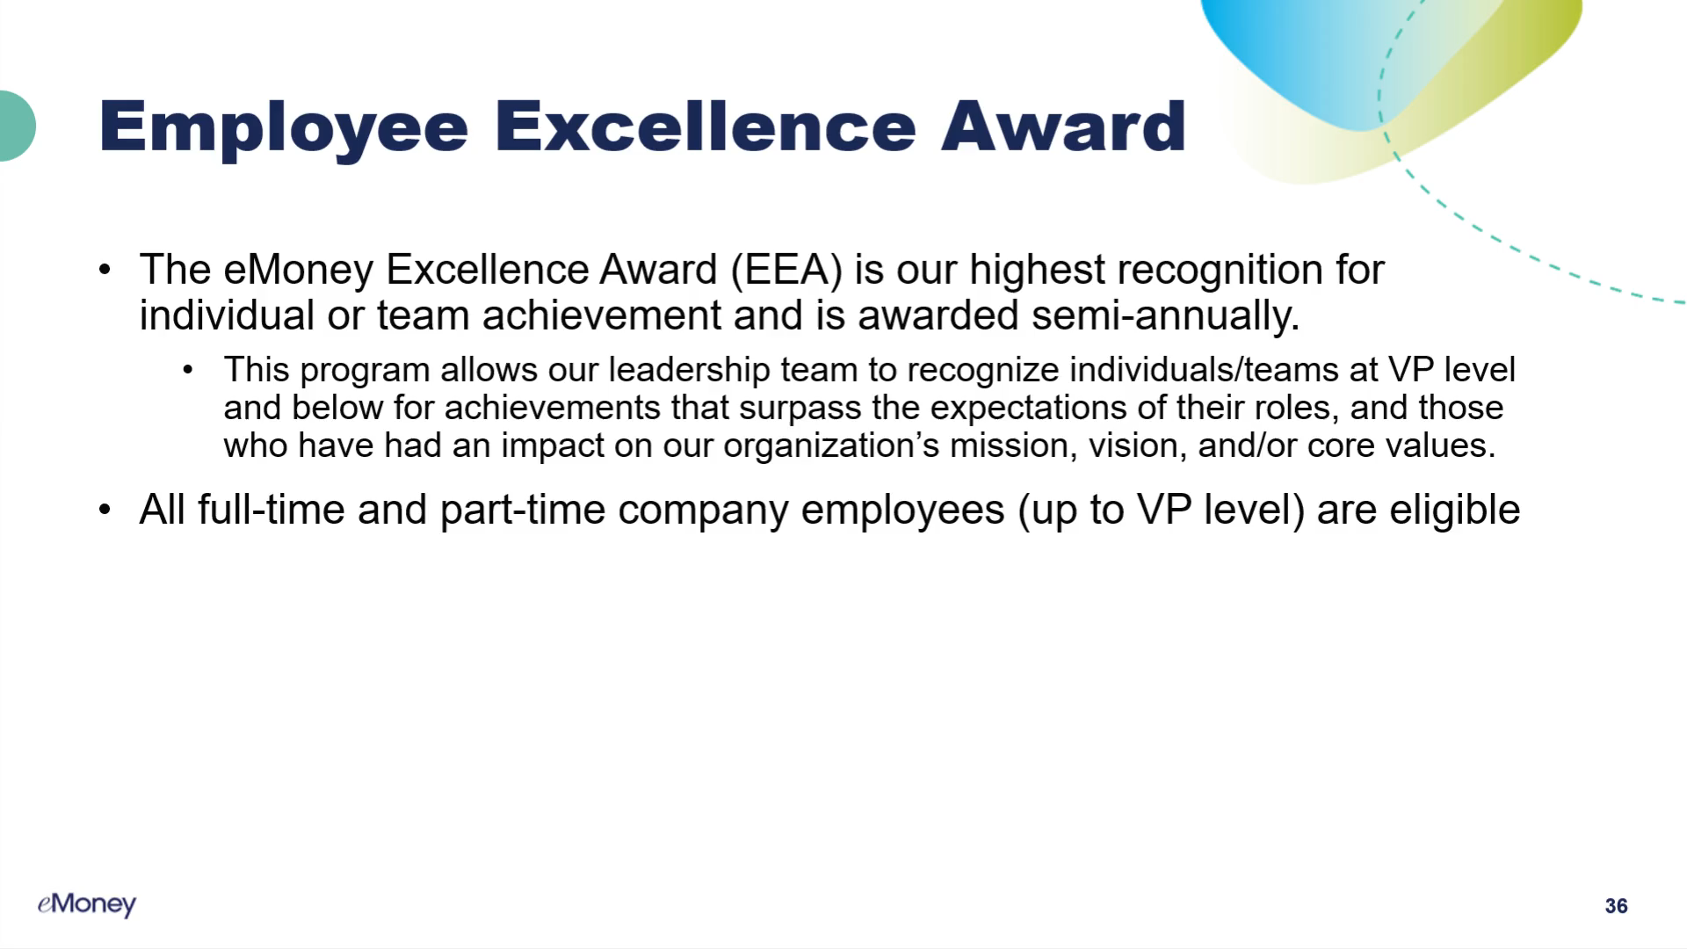
Employee Excellence Award
The eMoney Excellence Award (EEA) is our highest recognition for individual or team achievement and is awarded semi-annually.
  This program allows our leadership team to recognize individuals/teams at VP level and below for achievements that surpass the expectations of their roles, and those who have had an impact on our organization’s mission, vision, and/or core values.
All full-time and part-time company employees (up to VP level) are eligible
Notes:
Voice over.... so we know we could go on about these programs and tell you how great they are, BUT... we thought you might like to hear from some of your colleagues directly who were recipients:

Slide 38


Video Testimonials

Slide 39

EEA Recipient testimonials and videos
“I am a relatively new eMoney employee and to be honored so early in my time here is something I did not think possible. I always give 110% to deliver features that are of value to our customers and our team; knowing that eMoney notices and appreciates this will continue to push me to achieve great things.” - Dennis Smith
"The main feeling I had after receiving the EEA was appreciation. Appreciation for having all of my hard work both recognized as well as awarded. It may sound obvious that an employer would recognize hard work by its employees, but unfortunately a lot of times and with a lot of employers, it's not like that. I received the award after a significant time of hard work on a lot of projects, putting in a lot of hours, while going through a significant transition of my team. So to have my (and my team’s) efforts appreciated, it really meant a lot to me. I think the EEA as well as other programs that recognize and award effort and going above and beyond by employees are extremely worthwhile, and I'm still very honored to have received this award." - Adam Buchanan
"I would like to say how truly honored I feel to accept an award that recognizes the contributions our CS Training & Development Team has put into the larger organizational to help with the overall successes of eMoney! I feel this is a win that should be celebrated by the entire team, because without them I wouldn’t be nearly as effective. It’s truly been the greatest joy of my career to work w/ such a dedicated team of professionals day-in and day-out over the past 9+ years. I really appreciate the recognition; eMoney is truly a very special place to work, and I look forward to celebrating future successes with the rest of the eMoney family for years to come!" - Michael Clark
“Wow! Thank you! Wow!” What made it extra special was that it was a team award. We work hard together to bring value to our clients, and I appreciated that the recognition included all of us. - Joel Ugwuebulem
I can’t begin to describe the joy I felt being granted this award after my time here at eMoney. I did not know that this existed within the company, but I am glad that it does. To be recognized and acknowledged by management for my merit is appreciated beyond words. Thank you eMoney for always showing appreciation to everyone here whether it be through incentives, collectibles, and gifts and now this award which recognizes us on an individual level for hard work and progression within the company. I hope to continue to show and prove my dedication to not only my work but to my fellow cohorts and the company as well. Thank you for allowing me to show my full potential. -ChazzMe Jones
Notes:
Play the videos first

Slide 40
EEA Recipient testimonials and videos
“I am a relatively new eMoney employee and to be honored so early in my time here is something I did not think possible. I always give 110% to deliver features that are of value to our customers and our team; knowing that eMoney notices and appreciates this will continue to push me to achieve great things.” - Dennis Smith
"The main feeling I had after receiving the EEA was appreciation. Appreciation for having all of my hard work both recognized as well as awarded. It may sound obvious that an employer would recognize hard work by its employees, but unfortunately a lot of times and with a lot of employers, it's not like that. I received the award after a significant time of hard work on a lot of projects, putting in a lot of hours, while going through a significant transition of my team. So to have my (and my team’s) efforts appreciated, it really meant a lot to me. I think the EEA as well as other programs that recognize and award effort and going above and beyond by employees are extremely worthwhile, and I'm still very honored to have received this award." - Adam Buchanan
"I would like to say how truly honored I feel to accept an award that recognizes the contributions our CS Training & Development Team has put into the larger organizational to help with the overall successes of eMoney! I feel this is a win that should be celebrated by the entire team, because without them I wouldn’t be nearly as effective. It’s truly been the greatest joy of my career to work w/ such a dedicated team of professionals day-in and day-out over the past 9+ years. I really appreciate the recognition; eMoney is truly a very special place to work, and I look forward to celebrating future successes with the rest of the eMoney family for years to come!“
- Michael Clark
“Wow! Thank you! Wow!” What made it extra special was that it was a team award. We work hard together to bring value to our clients, and I appreciated that the recognition included all of us. - Joel Ugwuebulem
I can’t begin to describe the joy I felt being granted this award after my time here at eMoney. I did not know that this existed within the company, but I am glad that it does. To be recognized and acknowledged by management for my merit is appreciated beyond words. Thank you eMoney for always showing appreciation to everyone here whether it be through incentives, collectibles, and gifts and now this award which recognizes us on an individual level for hard work and progression within the company. I hope to continue to show and prove my dedication to not only my work but to my fellow cohorts and the company as well. Thank you for allowing me to show my full potential. - ChazzMe Jones
Notes:
Play the videos first

Slide 41


